Slide 1
Nutrition
Mrs. Scott
Health Class

Slide 2
What is Nutrition?
The process by which the body takes in and uses food.
Food choices are important because not all foods offer the same benefits to the body.

Slide 3
What is a Calorie?
A Calorie is a unit of heat or energy used by the body, that is provided to the body by food consumption.
It is the energy that fuels everything you do (exercising, doing homework, etc).

Slide 4
Hunger and Appetite
Yes, there is a difference!
Hunger is the actual physical need for food to prevent starvation.
Empty stomach, walls contract- signals nerve endings- send a message to brain that you need food.
After you eat the walls are stretched and nerve endings are not signaled.
Appetite is the desire to eat, not a need. This is triggered by your emotions and your environment.
Emotions like stress and depression can make some people want to eat.
People also tend to eat when they’re bored.

Slide 5
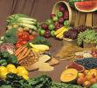
Nutrients
These are Carbohydrates, Fiber, Proteins, Lipids, Vitamins, and Minerals.
Your body needs these to function properly.

Slide 6
Carbohydrates
Starches and Sugars present in foods.
Provides 4 calories per gram.
Provides energy.
Most nutritionists recommend that 55-60% of your daily calories come from carbohydrates (especially complex carbs)

Slide 7
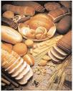
Two Types
Complex Carbs- starches found in whole grains, legumes, and tubers. The body breaks these down into simple carbs to use for energy.
Simple Carbs- sugars like fructose (in fruit) and lactose (in milk) and also sucrose (table sugar).

Slide 8
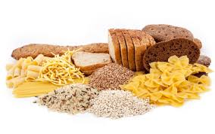
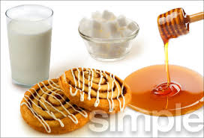
The difference in carbs
Complex carbs:
Starches
Provide long lasting energy
(bread, pasta, rice, whole grain cereal, oats)
Simple Carbs
Sugars
Provide quick, short acting energy
(fruit sugar, milk sugar, candy)

Slide 9
Fiber
Indigestible complex carbohydrate
Found in: tough stringy parts of vegetables, fruits, and whole grains.
Helps move waste through the digestive system, prevents intestinal problems like constipation, and lowers risk for colon cancer.

Slide 10
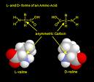
Proteins
Roles:
Build and maintain body cells and tissues (muscles)
Replaces worn out/damaged cells with new ones.
Made up of amino acids
there are 20 different amino acids, your body can manufacture all but 9 of them, these 9 are known as essential amino acids, you must get these from food.
4 cals/gram

Slide 11
Two Types of Proteins
Complete Proteins- contain all 9 essential amino acids. Animal products (meat, fish, poultry, eggs, cheese, yogurt, many soybean products).
Incomplete Proteins- lack one or more of the 9 essential amino acids, so when paired together they make a complete. Plant sources.
(beans, peas, nuts, grains) ex: peanut butter and bread, rice and beans.

Slide 12
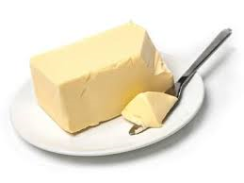
Fats
They transport vitamins and serve as a source of linoleic acid which is needed for growth and healthy skin.
(9 cals/gram)
Two Types: Saturated and Unsaturated
Saturated- holds all the hydrogen atoms it can. Usually solid at room temperature and found in animal fats. High intake can lead to an increased risk of heart disease. Bad fat
Unsaturated- missing one or more hydrogen bonds. Vegetable fats (olive oil, corn oil), usually liquid at room temp, reduces risk of heart disease.
Healthy fat

Slide 13
Vitamins
Compounds that help regulate many vital body processes (digestion, absorption, metabolism of other nutrients).
Two Types:
Water-Soluble
Not stored by the body, need replenishing
C, B-1, B-2, B-12, Niacin, Folic Acid
Fat-Soluble
Stored in the liver, kidneys, and fat
A, D, E, K

Slide 14
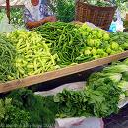
Folic Acid
Very Important Water-Soluble Vitamin!
Necessary for production of genetic material and normal red blood cells
Pregnant women need this to help reduce risks of spinal birth defects.
Where to get it: Orange Juice, Fortified Cereals, Green Veggies, Nuts.

Slide 15
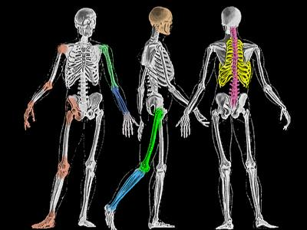
Minerals
Substances that the body cannot make but are needed for forming healthy bones, teeth, and regulating body processes.
Calcium and Iron are examples

Slide 16
Water
Vital to every body function. Transports other nutrients and carries wastes, lubricates joints and mucous membranes, regulates body temperature through perspiration, enables you to swallow and digest foods, and eliminates waste.
Important to drink at least 8 cups a day. (That’s a 1/2 gallon), obviously this is an average some people need more, some less.
Other than plain water other good sources are milk, and juice. NOT SOFT DRINKS AND OTHER CAFFINATED DRINKS! Pregnant and nursing women need even more water.

Slide 17
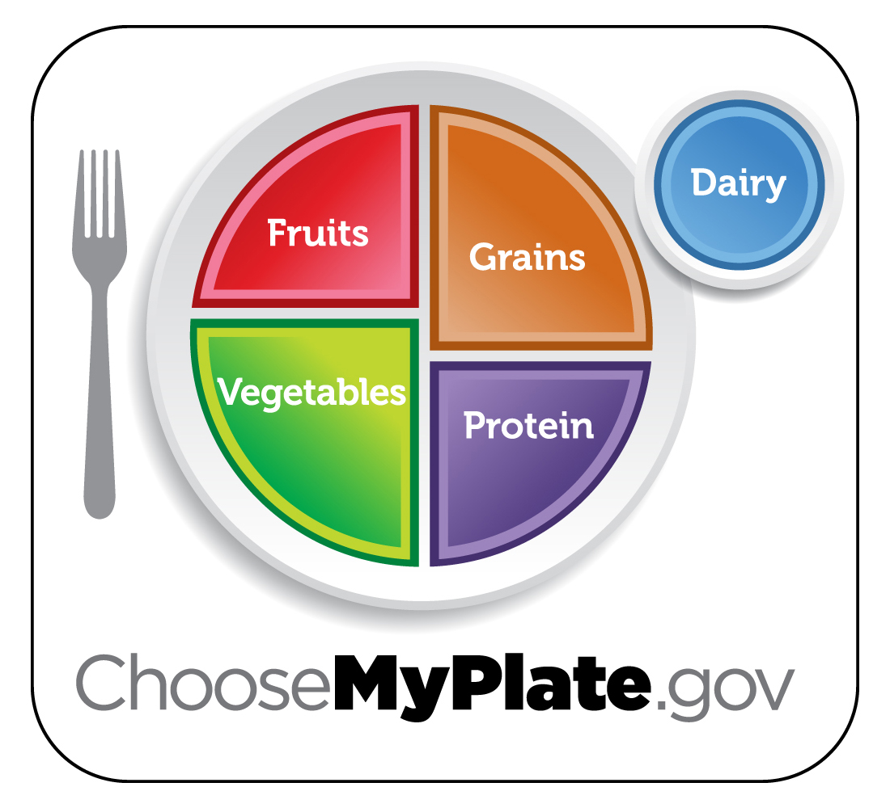
Lessons 3 and 4 Notes
The Dietary Guidelines for Americans is a set of recommendations about smart eating and physical activity for all Americans.
MyPlate is the new FPG. It’s an interactive guide to healthy eating and active living, you can get to it by going to choosemyplate.gov.

Slide 18
Your best choices in terms of eating:
Focus on Fruits
Vary your Vegetables
Get calcium-rich foods
Make half your grains whole
Go lean with protein
Limit certain foods (those high in fat, sugar, salt)
Do you feel it would be hard to do any of these??

Slide 19
Portion Control
Instead of eating 3 big meals…(sometimes we tend to overeat if we just eat 3 times)
Eat 5-6 smaller meals throughout the day.
Eat a healthy snack between breakfast and lunch and another between lunch and dinner.
Ex: natural peanut butter and apple slices (morning) hummus and carrot sticks (afternoon)

Slide 20
The importance of breakfast:
Your body needs to refuel after sleeping or you’ll be dragging all day.
Breakfast eaters tend to be more alert in their classes than those who didn’t eat breakfast.
Be sure to choose healthy options (not junk).
No time for breakfast? Grab a piece of fruit, eat a peanut butter sandwich, make a smoothie.

Slide 21
Healthy Snacks
Let’s come up with a list of healthy snacks as a class:

Slide 22
Food portions at restaurants
Are they bigger or smaller than the portion size a person should eat?
Way Bigger!!!

Slide 23
Healthy tips when eating out:
Watch your portion sizes (split the meal with a friend or take half of it home)
Choose grilled, baked or broiled foods over fried.
Add fresh veggies and fresh fruits if possible as sides.
Go easy on toppings (cheeses, mayo, creamy dressings, butter, sour cream aren’t very healthy choices)
Don’t drink your calories. There are lots of calories in soft drinks and lots of calories and fat in a lot of coffee drinks, choose water.

Slide 24
Food labels- good sources of info

Slide 25
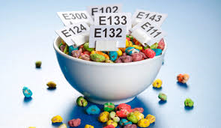
What are food additives?
Substances added to a food to produce a desired effect.
ex- diet sodas and diet food has aspartame to sweeten them without calories, cereals have colors added so kids want to eat it, etc.

Slide 26
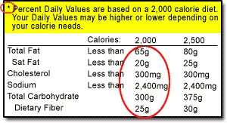
Percent Daily Value on food labels
Approximately how much of a nutrient a person on a 2,000 a day diet should consume of that nutrient/daily.

Slide 27
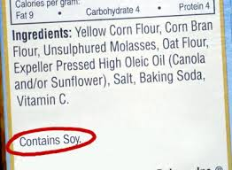
Ingredients
Ingredients on a food labels are listed from greatest to least in the product.
You can look through the ingredients and look here if you have an allergy to watch out for.

Slide 28
What do these terms mean?
3 Light/lite -Calories have been reduced by 1/3 or fat/calories have been reduced by ½.
4 Reduced -Food contains 25 percent less of a nutrient or calories.
2 Free -Food contains no total fat, saturated fat, sugar, etc.
6 Low -Food is low in fat and has limited amts of sodium and cholesterol
5 High/Excellent Source Of -Food contains 20% more of the Daily Value for a vitamin, mineral, protein, or fiber.
1 Good Source Of -Food contains 10-19% more of the Daily Value for a vitamin, protein, etc.
7 Healthy -You can eat this food regularly without exceeding your daily limits of fat, sat. fat, calories.

Slide 29
Expiration Date: The last date a product is considered good to use. Be sure to check medications as well.
Freshness Date: The last date an item with a short shelf life is considered fresh. Ex: baked goods (cookies and bread from the bakery section)
Pack Date: The date the product was packaged. Usually they announce this if there is a recall on a product.
Sell-by-Date: The last date a store should be able to sell the item, after which the freshness is not guaranteed.

Slide 30
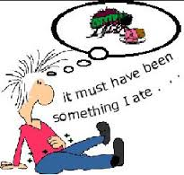
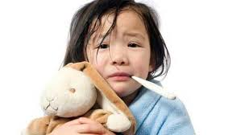
Foodborne Illness
Food poisoning caused from improper growing, packaging and/or cooking.
Bacteria like E coli, botulism, salmonella are examples
Vomiting, fever, diarrhea, very painful stomachache

Slide 31
4 Ways to Keep Food Safe
Clean- wash hands, counter, all utensils and foods.
Separate- keep raw meat away from other uncooked fruits and veggies.
Cook- cook food thoroughly
Chill- Keep cold foods cold, especially those with eggs and dairy in them.

Slide 32
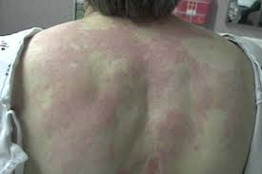
Food Allergy
An immune system reaction to a food
Rash, hives, swelling, throat tightening are common symptoms.
Epi-pens for severe reactions.
Peanuts, shellfish, eggs, wheat are common foods.
Call 911 immediately

Slide 33
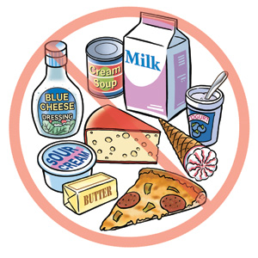
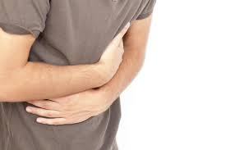
Food Intolerance
Eating a food that causes gas, bloating, and stomach pain each time you eat it.
Doesn’t affect the immune system.
Milk is a common culprit (lactose intolerance)

Slide 34
Works Cited
Glencoe Health Book Ch. 10 Lessons 1, 2, 3, 4

