Slide 1
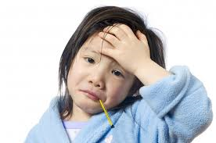
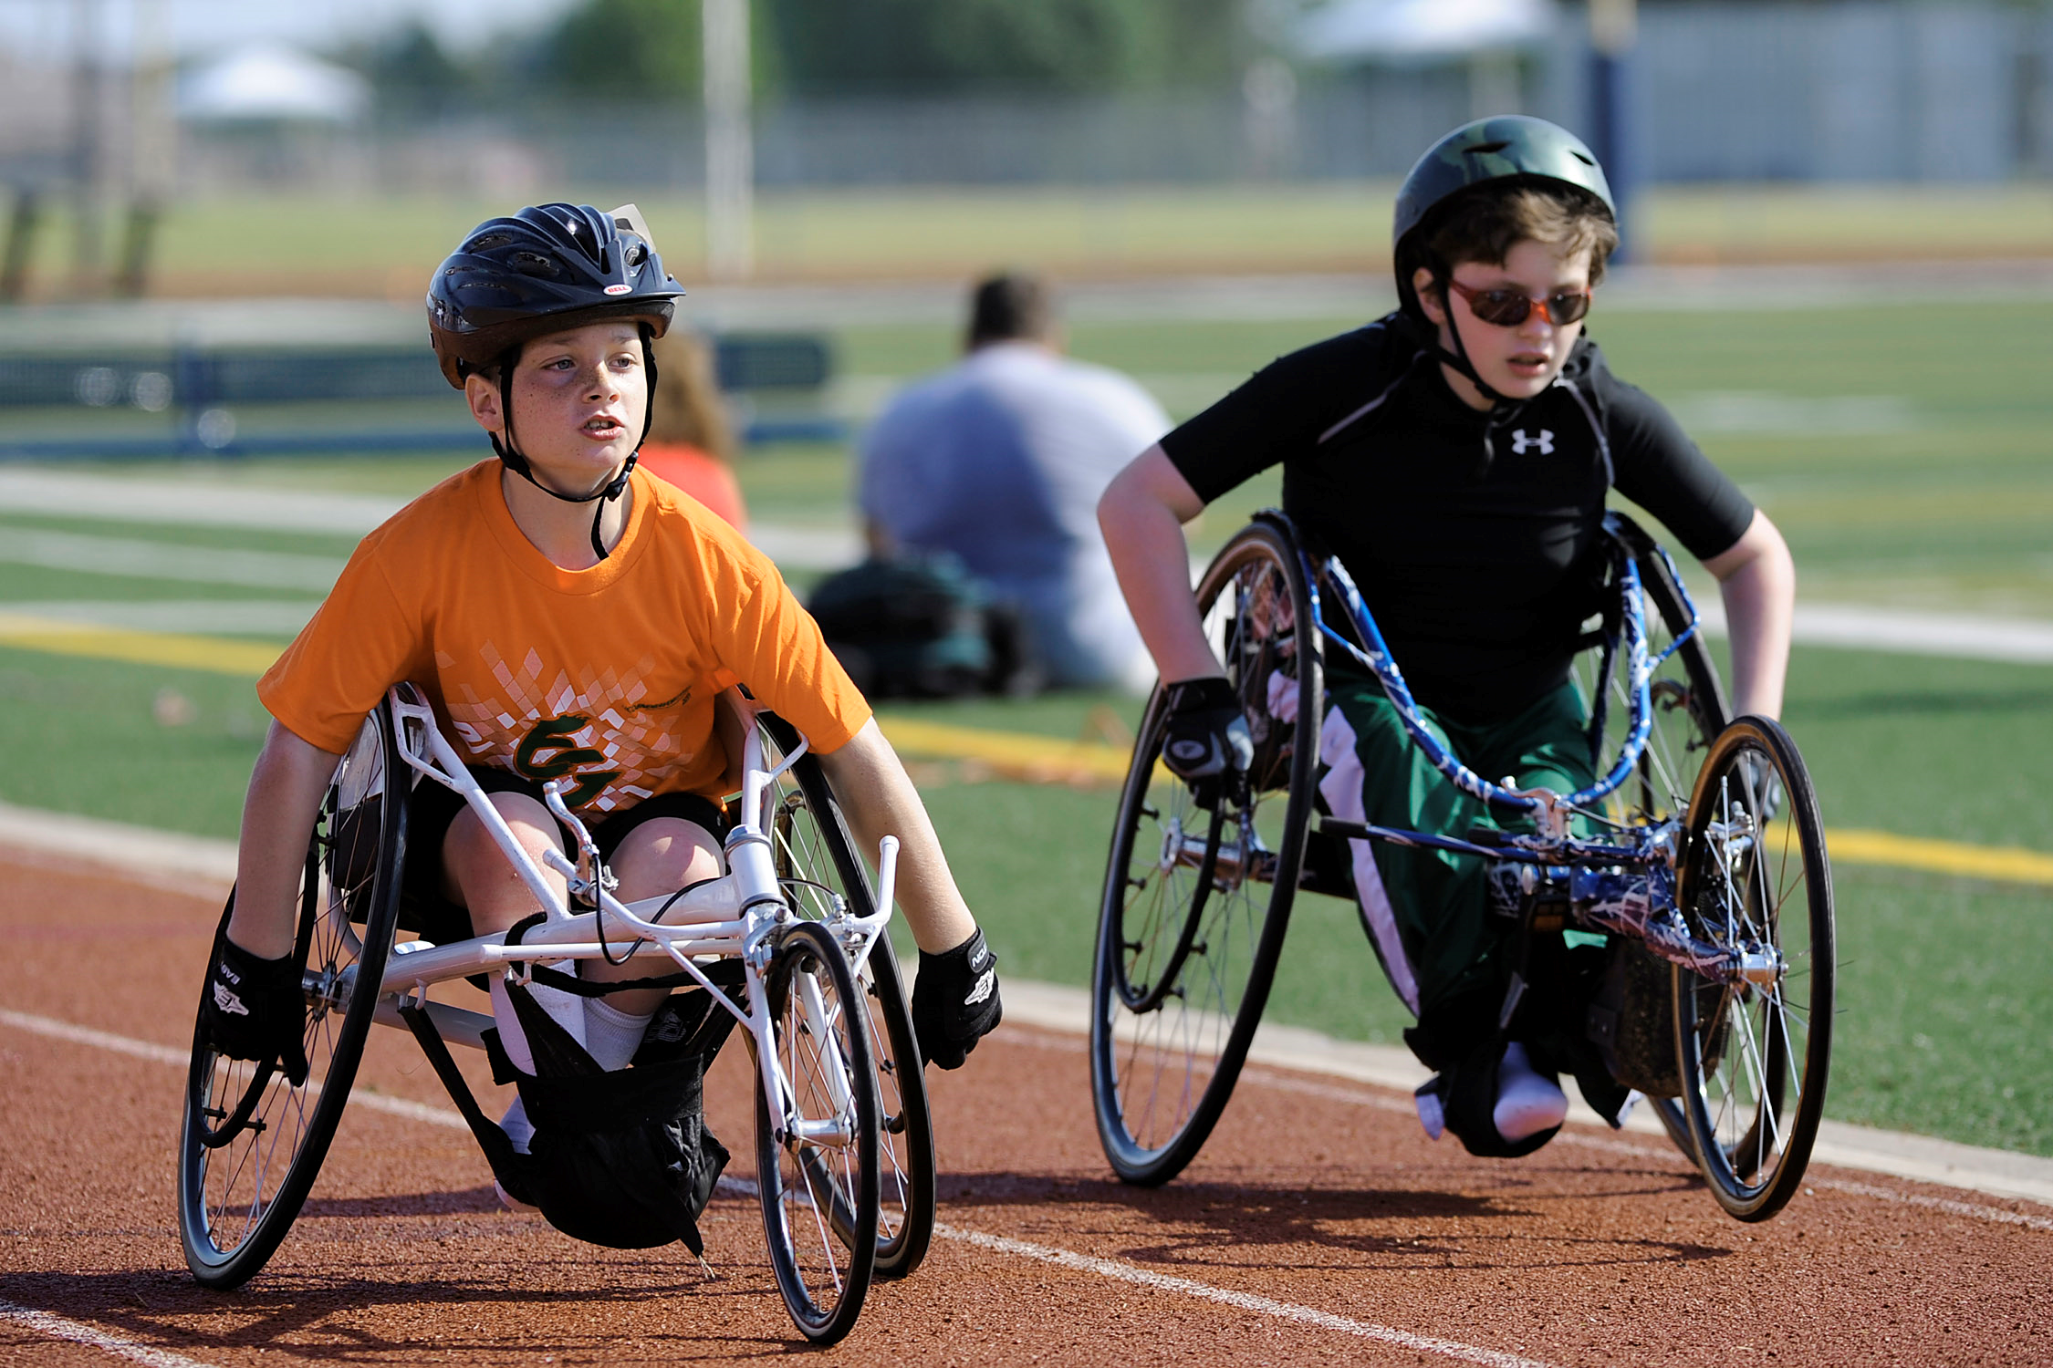
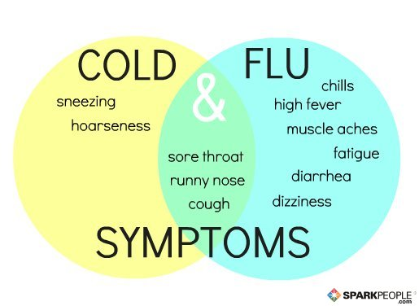
Ch 23 and 25 Diseases Notes Communicable, Non-communicable Diseases and Disabilities
Mrs. Scott’s Class

Slide 2
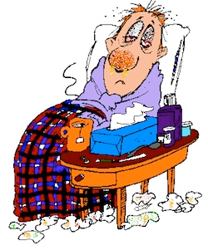
Common Cold
Caused by: VIRUS
Symptoms: SNEEZING, RUNNY NOSE, SORE THROAT
Treatment: REST AND FLUIDS, ANTIVIRALS (TYLENOL COLD, ETC)

Slide 3
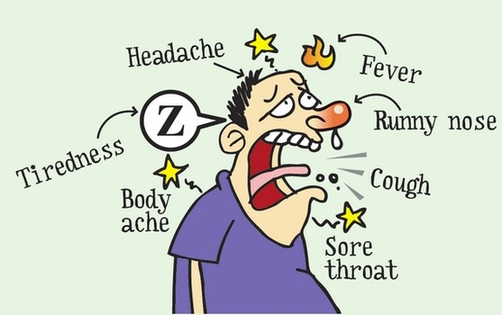
Influenza
Caused by: VIRUS
Symptoms: HIGH FEVER, FATIGUE, HEADACHE, BODY ACHES, COUGHING
Treatment: REST AND FLUIDS, ANTIVIRALS
Prevention: FLU VACCINE

Slide 4
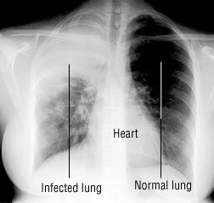
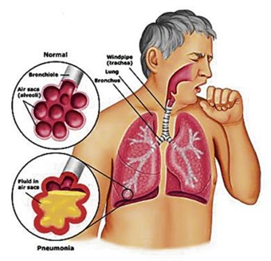
Pneumonia:
What is it: INFECTION IN WHICH THE AIR SACS FILL UP WITH FLUID AND PUS (INFECTION)
Symptoms: CHEST PAIN, COUGHING, TROUBLE BREATHING
Caused by: BACTERIA OR VIRUS (depends on the strain)
Treatment: ANTIBIOTICS (BACTERIAL), ANTIVIRALS (VIRAL)
https://www.youtube.com/watch?v=LwmYNgkAfBo
Difference between pneumonia and bronchitis)

Slide 5
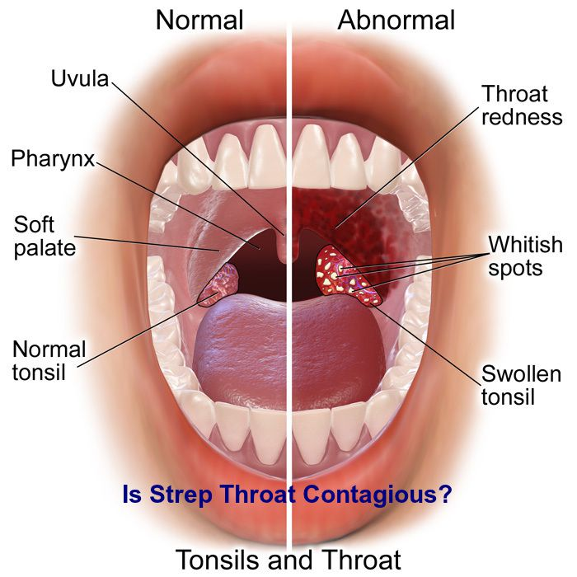
Strep Throat:
Caused by: BACTERIA
Symptoms: SORE THROAT, FEVER, ENLARGED
LYMPH NODES, WHITE SPOTS IN THE BACK OF
THE THROAT
Treatment: ANTIBIOTICS
https://www.youtube.com/watch?v=aubql8gD6qg

Slide 6
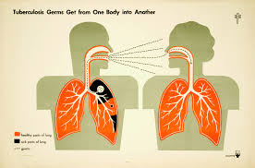
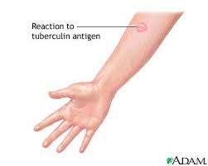
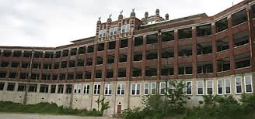
Tuberculosis:
What organ is affected: LUNGS
Caused by: BACTERIA
Treatment: ANTIBIOTICS, SOMETIMES SEVERAL AT ONE TIME BECAUSE THE STRAINS MUTATE
SYMPTOMS ARE NIGHT SWEATS, FEVER, WT. LOSS, FATIGUE AND COUGHING

Slide 7
Ahhh-Choo! Video
https://www.youtube.com/watch?v=qKiQA5e-fPg
Mythbusters The safe sneeze
https://www.youtube.com/watch?v=3vw0hIs2LEg

Slide 8
Hepatitis A, B, C (ALL ARE VIRUSES)
A- Caused by: CONTACT WITH THE INFECTED FECES OF A PERSON Symptoms: VOMITING, FEVER, ABDOMINAL PAIN Preventions- VACCINE, WASH YOUR HANDS AFTER GOING TO THE BATHROOM! STAY AWAY FROM INFECTED PEOPLE! Treatment: REST AND FLUIDS | B- Caused by: SEXUAL CONTACT, BODILY FLUIDS Symptoms: SIMILAR TO TYPE A BUT CAN CAUSE LIVER FAILURE Treatment: REST AND FLUIDS Preventions: ABSTAIN FROM SEX, DON’T SHARE PERSONAL ITEMS (TOOTHBRUSHES, RAZORS), IF YOU ARE GOING TO GET PIERCED OR GET A TATTOO MAKE SURE THEY ARE USING NEW NEEDLES! | C- Caused by: BLOOD Symptoms: JAUNDICE, DARK URINE, FATIGUE, LOSS OF APPETITE, CAN LEAD TO CHRONIC LIVER DISEASE, LIVER CANCER AND FAILURE Treatment: REST AND FLUIDS Preventions: DON’T SHARE NEEDLES! ABSTAIN FROM SEX, DON’T SHARE PERSONAL ITEMS (TOOTHBRUSHES, RAZORS), IF YOU ARE GOING TO GET PIERCED OR GET A TATTOO MAKE SURE THEY ARE USING NEW NEEDLES!

Slide 9
KEEP IN MIND:
ALL STD’s are communicable diseases. Examples: Pubic Lice, Chlamydia, Syphillis, Gonorrhea, AIDS, Genital Warts, Herpes, etc. We’ll be discussing these next week.

Slide 10
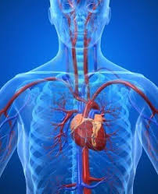
Cardiovascular Disease:
What is it: DISEASE THAT AFFECTS THE HEART AND BLOOD VESSELS
Death Fact: ALMOST 40% OF ALL US DEATHS, #1 KILLER FOR MEN AND WOMEN
Main causes (pg 690): HIGH BLOOD PRESSURE, STIMULANT USE, BEING OVERWT, LACK OF EXERCISE, POOR DIET
Preventions pg 693: AVOID TOBACCO AND OTHER STIMULANT USE, AVOID EXCESSIVE ALCOHOL USE, HAVE BLOOD PRESSURE AND CHOLESTEROL CHECKED, EAT HEALTHY DIET, EXERCISE, MAINTAIN A HEALTHY WT, USE STRESS MANAGEMENT TECHNIQUES.

Slide 11
Heart attacks and Strokes
Heart Attack:
What is it: HEART IS DEPRIVED OF BLOOD RESULTING IN DAMAGE TO THE HEART MUSCLE.
Common Symptoms: INTENSE CHEST PAIN, SHORTNESS OF BREATH, ARM PAIN (left)
What should you do if someone displays the symptoms: CALL 911 RIGHT AWAY!
Stroke:
What is it: BLOOD FLOW TO THE BRAIN IS BLOCKED
Common Symptoms: DIZZINESS, SEVERE HEADACHE, SLURRED SPEECH, CONFUSION, NUMBESS ON ONE SIDE OF THE BODY, DROOPING OF ONE SIDE OF THE FACE
What should you do if someone displays the symptoms: CALL 911 RIGHT AWAY!
https://www.youtube.com/watch?v=ZJ4shANmIN8
http://www.clearlyhealth.com/videos/cardiovascular/heart_attack_causes

Slide 12
Cancer
Cancer Preventions pg 699: AVOID TOBACCO AND ALCOHOL, PROTECT YOUR SKIN FROM UV RAYS, PRACTICE ABSTINENCE, BE PHYSICALLY ACTIVE, MAINTAIN HEALTHY WT, EAT HEALTHY, RECOGNIZE THE WARNING SIGNS
Treatments:
SURGERY, RADIATION THERAPY, CHEMOTHERAPY, IMMUNOTHERAPY, HORMONE THERAPY
https://www.youtube.com/watch?v=uDI5a5Z7gUw
https://www.youtube.com/watch?v=sJb_BZLhx8k
What is it: UNCONTROLLABLE GROWTH OF ABNORMAL CELLS
Benign: “BE FINE” NON CANCEROUS
Malignant: CANCEROUS
Types:
Lymphoma- CANCER OF THE IMMUNE SYS.
Leukemia- CANCER OF THE BLOOD/BLOOD FORMING ORGANS
Carcinomas-CANCER OF THE SKIN, GLANDS, DIGESTIVE TRACTS, LUNGS
Sarcomas-CANCER OF THE CONNECTIVE TISSUE (BONES, LIGAMENTS, MUSCLES)

Slide 13
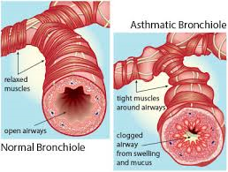
Allergies & Asthma
Allergies:
Cause: SPECIFIC REACTION OF THE IMMUNE SYS TO A FOREIGN AND FRQUENTLY HARMLESS SUBSTANCE
Symptoms: RUNNY NOSE, ITCHY WATERY EYES, SORE THROAT, SNEEZING, THROAT OR TONGUE SWELLING, HIVES/RASH
Treatment: ANTIHISTAMINES (NORMAL) OR EPIPEN (FOR EXTREME)
Asthma:
Cause: INFLAMMATION OF THE SMALL AIRWAYS MAKING IT HARD TO BREATHE TYPICALLY BY A SPECIFIC TRIGGER (PET DANDER, MOLD, POLLEN, TOO MUCH EXERCISE
Treatment/Management: INHALER, STAY AWAY FROM TRIGGER, MANAGE STRESS LEVEL

Slide 14
Diabetes 1 and 2 (recap)
Diabetes (Type 1)
Cause: NO KNOWN CAUSE, PANCREAS IS NOT FUNCTIONING AT ALL
Age usually acquired: YOUNG AGE
Symptoms: FREQUENT URINATION, INCREASED THIRST, UNEXPLAINED WT LOSS, SUDDEN VISION CHANGES, TINGLING HANDS AND FEET, FATIGUE, SORES THAT ARE SLOW TO HEAL, MORE INFECTIONS THAN USUAL. NON-preventable.
Treatment: NO CURE- INSULIN INJECTIONS BY SHOT OR PUMP DAILY
Diabetes (Type 2)
Cause: BEING OVERWT, POOR DIET, LACK OF EXERCISE, PANCREAS IS WORKING BUT NOT LIKE IT SHOULD.
Treatment: CHANGE IN DIET AND EXERCISE, SOMETIMES MEDICATIONS
100% preventable

Slide 15
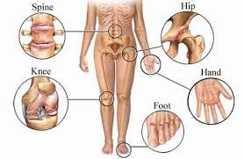
Arthritis:
Cause: DISEASES THAT CAUSE PAIN AND LOSS OF MOVEMENT IN THE JOINTS
Treatment: ANTI-INFLAMMATORY MEDS/SHOTS, THERAPY
Prevention: CONTROL YOUR WT, STAY ACTIVE, PREVENT SPORTS INJURIES, PROTECT AGAINST LYMES DISEASE

Slide 16
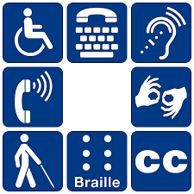
Disabilities:
ANY PHYSICAL OR MENTAL IMPAIRMENT THAT LIMITS NORMAL ACTIVITIES (SEEING, HEARING, MOVEMENT, SPEAKING)
Is a disability communicable/catchable? NO!

Slide 17
Sight, Hearing and Motor Disabilities
Sight Impairment- ANY IMPAIRMENT TO YOUR VISION. BROAD SPECTRUM FROM READING GLASSES TO BLINDNESS
Hearing Impairment- ANY IMPAIRMENT TO YOUR HEARING. BROAD SPECTRUM FROM SLIGHT TO DEAFNESS. CAN BE CAUSED BY HEREDITY, INJURY, DISEASE, OBSTRUCTION, NERVE DAMAGE.
If your music can be heard by the person sitting next to you, it’s too loud, turn it down! You could make yourself have hearing loss!
Motor Impairment- Impairment that limits someone from doing simple tasks, lifting a glass, tying a shoe, opening a jar, etc.

Slide 18
Mental Challenges-
CAN BE IQ IS LOWER THAN AVERAGE CAUSING A DELAY IN LEARNING, INCLUDE MENTAL DISABLITIES THAT LIMIT ONE FROM LIVING ON THEIR OWN AND/OR IQ COULD BE REALLY HIGH BUT SOCIALLY THEY AREN’T WHERE THEIR PEERS ARE. LEARNING DISABILITIES. BROAD SPECTRUM.
CAN BE CAUSED BY:
GENETIC DISORDER (DOWN SYNDROME)
POOR BEHAVIOR CHOICES DURING PREGNANCY (DRUG USE, ALCOHOL USE)
RUBELLA INFECTION
RESTRICTED OXYGEN SUPPLY DURING BIRTH OR HEAD INJURY, STROKE, CERTAIN INFECTIONS IN OLDER INDIVIDUALS.

Slide 19
Americans with Disabilities Act-
A LAW THAT PROHIBITS DISCRIMINATION AGAINST PEOPLE WITH DISABILITES IN THE WORKPLACE, TRANSPORTATION, PUBLIC ACCOMODATIONS, TELECOMMUNICATIONS.
EX: RAMPS INTO BUILDINGS, EQUAL OPPORTUNITY FOR JOBS, CLOSED CAPTION ON TV AND PHONES, ETC.

Slide 20
Videos
Disability Video Clips
Kyle Maynard http://www.youtube.com/watch?v=jqRJ-178dVk (8:00)
Kyle Maynard http://www.youtube.com/watch?v=x4WN1QVwq9k (5:00)
Anthony Robles http://www.youtube.com/watch?v=QxTnjHvKPRY
Little Couple (would they choose to be average size) http://www.youtube.com/watch?v=br85ie5aqlM
Little Couple (having a child) http://www.youtube.com/watch?v=O5-HQAYB-eE
Boy with Autism plays in the bball game http://www.youtube.com/watch?v=l2IU1h9sG7U
Dancing with the stars Noah Galloway: https://www.youtube.com/watch?v=NhXu4X1Iai0
NYLES on DWTS (deaf dancer)
https://www.facebook.com/1day1dance/videos/vb.638123092917126/1077894612273303/?type=2&theater
https://www.youtube.com/watch?v=e_nIIcZBI54 (Nyles most memorable year)
https://www.youtube.com/watch?v=EGbt7cjhHHA (Nyle and Peta)

