Slide 1
Ch. 2 Health Skills
Mrs. Scott

Slide 2
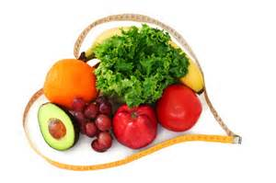
In this chapter…
Learning health skills can help a person stay healthy throughout his/her life
You actively promote well being by making healthy choices and setting positive goals.
Health Literate individuals, which we learned about in Chapter 1, can carefully evaluate health products and services to make the right choices.

Slide 3
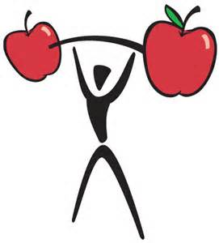
Health Skills
Specific tools and strategies to maintain, protect, and improve all aspects of your health. Health skills can also be called Life Skills.
How can teens use skills, such as decision making and communication skills to enhance their health? (decision making skills to avoid behaviors that harm health such as tobacco or alcohol.)

Slide 4
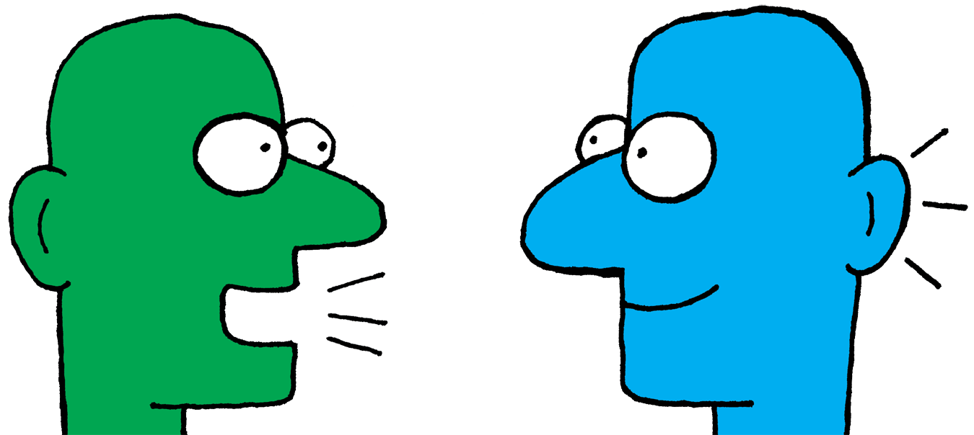
Interpersonal Communication
The exchange of thoughts, feelings, and beliefs between 2 or more people. Helps you build strong relationships with others.
Learning to be an effective communicator can enhance your health. Examples include: sharing things with a trusted adult or friend, talking to a teacher or counselor about something, or expressing your feelings in a healthy way.

Slide 5
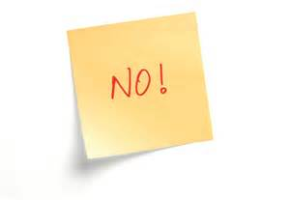
Refusal Skills
Communication Strategies that can help you say NO when you are urged to take part in behaviors that are unsafe or unhealthy, or that go against your values. (offered a cigarette or alcohol at a party or pressured to have sex)
Say NO, Explain WHY, Offer Alternatives, Stand your ground, or LEAVE if necessary!!!

Slide 6
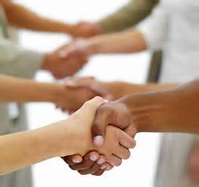
Conflict Resolution
The process of ending a conflict through cooperation and problem solving.
Healthy Teens handle conflict thru talking it out and compromise. NOT FIGHTING OR POSTING STUFF ON SOCIAL MEDIA!!!!!!!!!!!!!!!!!

Slide 7
Stress Management Skills
Skills that help you reduce and manage stress in your life.
What are some ways you manage stress in your life? Sports, talking to a family member or friend that you trust, running, diet, sleep, writing in a journal, hanging out with friends…

Slide 8
Advocacy
Taking action to influence others to address a health related concern or to support a health related belief. Encouraging others to practice healthy behaviors.
Who are other health advocates here at NAHS?
What are some ways you can advocate good health to members of your own family? (grocery shop with mom)

Slide 9
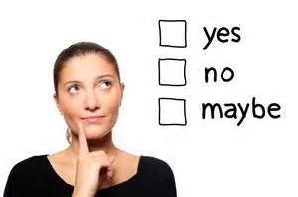
Values- ideas, beliefs, and attitudes about what is important that guide the way you live. (Honesty, Respect, Hard Work, Abstinence, etc…)
Decision Making Skills- steps that enable you to make a health decision/choice.
Is this decision HEALTHY? ETHICAL? LEGAL? PARENT APPROVED?
Scenario: You have been invited to a party at your friends house. She has an older sister who is a senior so you are excited to go and want to fit in, being a 9th grader. You know there will be underage drinking at this party. What do you do?

Slide 10
Goals-things you aim for that take planning and work
Short Term Goal- A goal you can reach in a short period of time (homework due, cut the grass)
Long Term Goal- A goal you plan to reach over an extended period of time (graduate, save $ to buy a car)
Action Plan- A written multi-step strategy to identify and achieve your goals

Slide 11
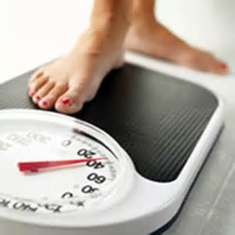
Develop an Action Plan to lose 10 lbs in 3-6 months…
Set a specific goal and WRITE IT DOWN
List the steps 1) exercise 3x a week 2) eat healthier 3) drink more water
Identify sources of help and support (parents, coach, friends, siblings)
Set a reasonable time frame to achieve goal- 3-6 months
Evaluate progress by establishing checkpoints. (weigh in)
Reward yourself for achieving your goal (buy new clothes, eat ice cream ☺)

Slide 12
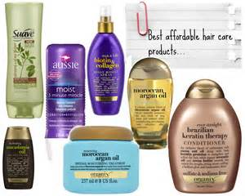
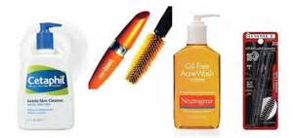
Health Consumer- someone who purchases or uses health products or services…YOU are a health consumer!
What are 2 Health products you buy on a regular basis? (toothpaste, deodorant, zit cream) WHEN BUYING SHAMPOO, WHAT KIND OF FACTORS DO YOU CONSIDER WHEN DECIDING BETWEEN DIFFERENT KINDS?
Advertising-written or spoken media message designed to interest consumers to purchase their product or service.
What is the last commercial, or advertisement you saw for a Health product/service?

Slide 13
“Hooks” advertisers use
Bandwagon- lots of people using it
Rich and Famous
Free Gifts
Great Outdoors- healthy
Good Times- people having fun
Testimonial- it worked for these people
Humor- it’s funny and grasps your attention

