Slide 1
Club Drugs and Other Drugs
Mrs. Scott
Health
Chapter 22
Copy down what is in YELLOW font. You can summarize if you want, however these are your notes.

Slide 2
What are “Club Drugs”?
Dangerous substances known collectively as club drugs-examples include: Ecstasy, GHB, and Rohypnol-are commonly found in teen dance clubs, this is why they are known as “Club Drugs”.

Slide 3
Club Drugs Cont.
Although users may think these substances are harmless, research has shown that club drugs can produce a range of unwanted effects, including hallucinations, paranoia, amnesia, and, in some cases, death.
When used with alcohol, these drugs can be even more harmful.

Slide 4
Dangerous!!
Because some club drugs are colorless, tasteless, and odorless,they are easy for people to slip into drinks.
Some of these drugs have been associated with sexual assaults, and for that reason they are referred to as "date rape drugs."

Slide 5
“Ecstasy”
"X," "Adam," and "Ecstasy" are slang names for MDMA, which is a stimulant and a hallucinogen.
Young people may use Ecstasy to improve their moods or get energy to keep dancing; however, chronic abuse of MDMA appears to damage the brain's ability to think and regulate emotion, memory, sleep, and pain.

Slide 6
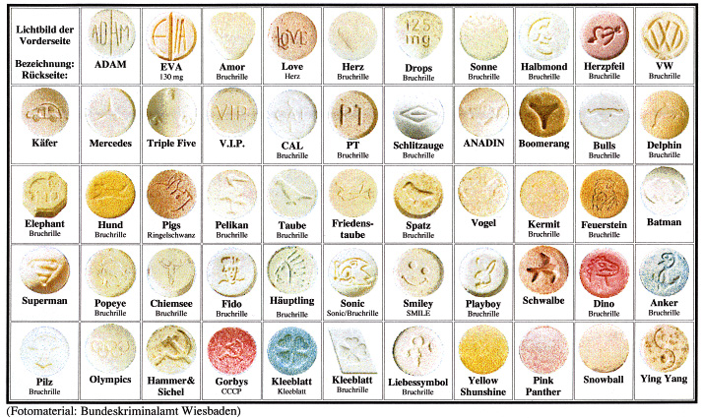
Picture of Ecstasy
Many ecstasy tablets have faces or images on them, they look like candy.

Slide 7
GHB
"G," "Liquid Ecstasy,“ or Gamma-hydroxybutyrate (GHB)
It’s a depressant
At lower doses, GHB can relax the user, but, as the dose increases, the sedative effects may result in sleep and eventual coma or death.
Used as a date rape drug

Slide 8
Rohypnol
"Roofie" or "Roche" (Rohypnol) is tasteless and odorless, easily mixed into drinks especially carbonated beverages
Depressant
Rohypnol may cause individuals under the influence of the drug to forget what happened.
Other effects include low blood pressure, drowsiness, dizziness, confusion, and stomach upset.
#1 Date Rape Drug

Slide 9
Rohypnol Facts

Slide 10
Other Drugs…

Slide 11
Ketamine
"Special K" or "K" (Ketamine) is an anesthetic (pain killer) and hallucinogen.
Use of a small amount of Ketamine results in loss of attention span, learning ability, and memory.
At higher doses, Ketamine can cause delirium, amnesia, high blood pressure, depression, severe breathing problems and death.

Slide 12
Ketamine Cont.
Ketamine is a liquid and the most potent ways of using it are by injecting it intramuscularly or intravenously.
It is used by vets as an animal tranquilizer and sometimes humans (severe burns). An easy way to remember this one: think “Catamine”
There is the risk of losing motor control before injection is completed.

Slide 13
Ketamine Cont.
Ketamine also can be made into a tablet, or a powder by evaporating the liquid and reducing it to a fine white powder that can be smoked or snorted.
Because of its appearance, Ketamine is often mistaken for cocaine or crystal methamphetamine.

Slide 14
Methamphetamine
"Speed," "Ice," "Chalk," "Meth" (Methamphetamine) is often made in home labs. These can blow up and cause injuries to anyone around the area.
It’s a powerful and addictive STIMULANT
Methamphetamine use can cause serious health concerns, including memory loss, aggression, violence, psychotic behavior and heart problems.

Slide 15
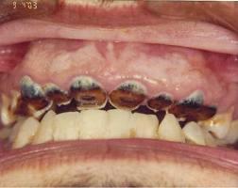
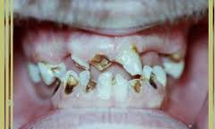
Meth. Cont.
Excess use of methamphetamine causes severe weight loss, pains in muscles and joints, excessive activity, noticeable change in appearance, dental issues and overconcentration on minor tasks. Some people become suspicious and develop antisocial behavior. (Kind of similar to paranoid
schizophrenia)

Slide 16
Meth. Cont.
It quickly produces feelings of joy, strength, and alertness.
Methamphetamine gives a user the capacity to work and talk for long periods of time.
Methamphetamine is one of a group of drugs called amphetamines.

Slide 17
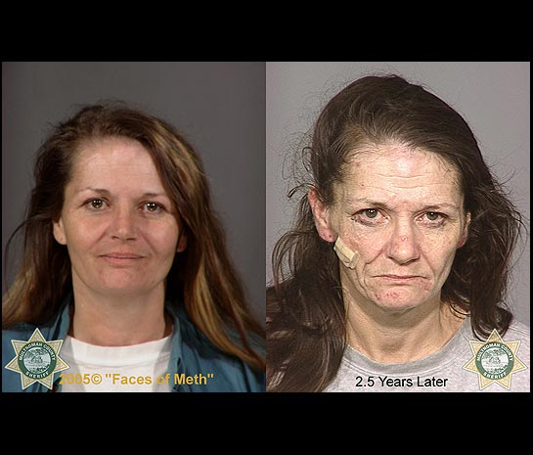
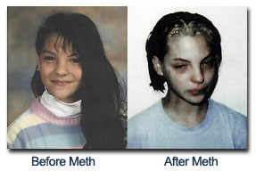
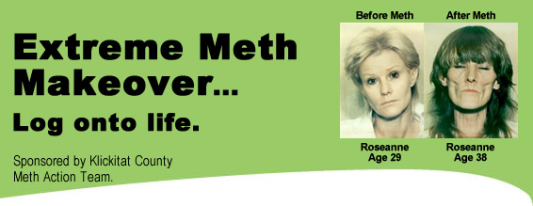
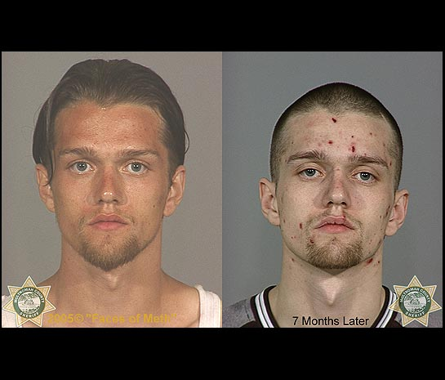
Pics of Meth Users
Before and After Meth

Slide 18
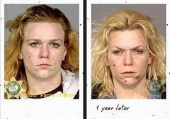
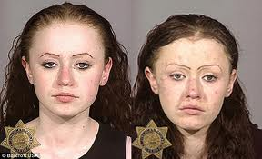
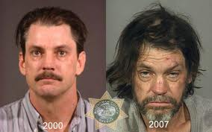
More Meth Pics

Slide 19
LSD
"Acid" or Lysergic Acid Diethylamide (LSD) may cause unpredictable behavior depending on the amount taken, where the drug is used, and on the user's personality.
A user might feel the following effects: numbness, weakness, nausea, increased heart rate, sweating, lack of appetite, "flashbacks and hallucinations" and sleeplessness.

Slide 20
LSD Cont.
These distortions include hallucinations, during which a person sees, hears, smells, or feels things that do not really exist. Severe impaired judgement goes along with hallucinogens (jumping off buildings, thinking they can fly, etc)
Many LSD users experience flashbacks, recurrence of certain aspects of a person's experience, without the user having taken the drug again. A flashback occurs suddenly, often without warning, and may occur within a few days or more than a year after LSD use.

Slide 21
LSD Cont.
LSD is odorless, colorless, and has a slightly bitter taste and is usually taken by mouth.
Often LSD is added to small decorative squares of absorbent paper, with each square representing one dose. It’s absorbed through the mouth into the bloodstream.

Slide 22
Opium
The Opium poppy (papaver somniferum) is the key ingredient for all narcotics.
Opium is the substance that is directly extracted from the poppy plant.
Opium is converted into Heroin in laboratories in the countries where it is cultivated, and then consumed locally or shipped to consumer countries. It takes approximately ten kilograms of Opium to make one kilogram of Heroin.

Slide 23
Opium Cont.
Opium
Codeine
(cough medicine)
Morphine
Heroin
Opium is divided into two distinct chemical classes.
One of these classes contains codeine and morphine.
Codeine is frequently used in prescription cough medicines.
They put you to sleep (low dose-cough medicine, higher dose- after surgery)

Slide 24
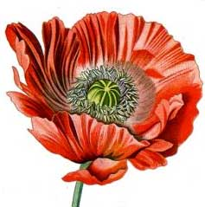
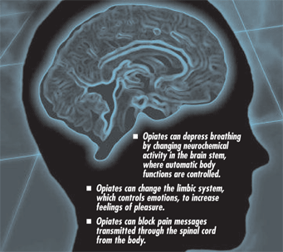
Opium Cont.
This is a
Picture of the
Poppy Plant→

Slide 25
PCP
PCP (phencyclidine) aka: Angel Dust is classified as a hallucinogen and has many of the same effects as LSD, but can be much more dangerous.
In the 1950's, PCP was investigated as an anesthetic, but due to its severe side effects, its development for human use was discontinued.
PCP is known for inducing violent behavior and for inducing negative physical reactions such as seizures, coma, death.

Slide 26
PCP Cont.
In its original state, PCP is a white crystalline powder.
PCP is available in tablet, liquid, and powder forms and is either ingested orally or smoked by applying the liquid form to tobacco or marijuana cigarettes or by lacing these and other cigarettes, sometimes containing herbs such as mint or parsley, with PCP powder.

Slide 27
PCP Cont.
There is no way to predict who will have a bad reaction to the drug. Maybe this is because PCP has so many faces--it can act as a hallucinogen, stimulant, depressant, and/or anesthetic---It depends on the user and it can affect the user differently each time.

Slide 28
Cocaine
Interesting Fact: In 1886, John Pemberton developed Coca Cola, a drink that contained cocaine and caffeine. Cocaine was REMOVED from Coca Cola in 1906 (but it still has the caffeine).
Cocaine is a local anesthetic and very powerful central nervous system stimulant. It can be taken by chewing on coca leaves, smoked, inhaled ("snorted") or injected.

Slide 29
Cocaine Cont.
Pure cocaine was first used in the 1880s as a local anesthetic in eye, nose, and throat surgeries because of its ability to provide anesthesia as well as to constrict blood vessels and limit bleeding.
Cocaine is no longer used due to new safer medications.

Slide 30
Cocaine Cont.
A dose of between 25 to 150 mg of cocaine is taken when it is inhaled. Within a few seconds to a few minutes after it is taken, cocaine can cause:
a feeling of euphoria
excitement
reduced hunger
a feeling of strength
Typically snorted

Slide 31
Cocaine Cont.
After this 1 hour high, users will experience a very depressive crash.
The crash is what causes people to become addicted.
Withdrawal from cocaine can cause the addict to feel depressed, anxious, and paranoid. The addict may then go into a period of exhaustion and they may sleep for a very long time.

Slide 32
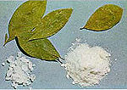
Cocaine
Various doses of cocaine can also produce neurological and behavioral problems like:
dizziness
headache
movement problems
anxiety
Insomnia
depression
hallucinations

Slide 33
Cocaine and Death
Death caused by too much cocaine (an overdose) is not uncommon.
Cocaine can cause large increases in blood pressure that may result in bleeding within the brain.
Constriction of blood vessels can also cause a stroke or heart attack. An overdose of cocaine can cause breathing and heart problems that could result in death.

Slide 34
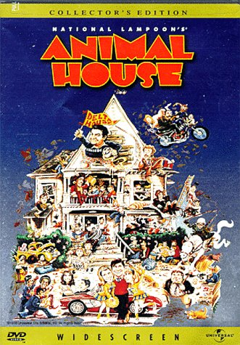
Cocaine and Death Cont.
Comedian John Belushi died from a cocaine/heroin overdose in 1982.
Whitney Houston was a frequent cocaine addict . There have been reports that it was in her system when she died. There were also reports that prescription depressants and alcohol were in her system.

Slide 35
Crack
Approximately 100 years after cocaine entered into use, a new variation of the substance emerged. This substance, crack, became enormously popular in the mid-1980s due in part to its almost immediate high and the fact that it is inexpensive to produce and buy compared to cocaine.

Slide 36
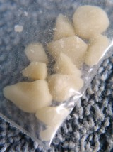
Crack Cont.
Crack is a highly addictive form of cocaine that is typically smoked.
The term "crack" refers to the crackling sound heard when the substance is heated, presumably from the sodium bicarbonate that is used in the production of crack.

Slide 37
Crack Cont.
While nearly always smoked, there are reports of users injecting crack.
Smoking crack delivers large quantities of the drug to the lungs, producing effects comparable to intravenous injection. These effects are felt almost immediately after smoking, are very intense, but do not last long.
The high from smoking crack/cocaine may last from 5 to 10 minutes, while the high from snorting the drug can last for 15 to 20 minutes.

Slide 38
Crack Cont.
Cocaine and Crack smokers may suffer from acute respiratory problems including coughing, shortness of breath, and severe chest pains with lung trauma and bleeding.
Smoking crack-cocaine can also cause particularly aggressive paranoid behavior in users.

Slide 39
Crack Cont.
An added danger of crack/cocaine use is when cocaine and alcohol are consumed at the same time. When these substances are mixed, the human liver combines cocaine and alcohol and manufactures a third substance, cocaethylene.
This intensifies cocaine's euphoric effects, while also possibly increasing the risk of sudden death.

Slide 40
Effects of drugs on pregnancy
http://on.aol.com/video/effects-of-drugs-on-pregnancy-516942799?icid=video_related_7

Slide 41
Amphetamines
Type: STIMULANT
Amphetamines are drugs such as dextroamphetamine, benzedrine, and Ritalin.
Amphetamines were originally developed for weight loss, to treat asthma, sleep disorders (narcolepsy) and hyperactivity.
Amphetamines are powerful and addictive stimulants of the central nervous system

Slide 42
Amphetamines Cont.
Many of the effects of amphetamines are similar to cocaine because they are stimulants. Addiction to and withdrawal from amphetamines are both possible.

Slide 43
Amphetamines Cont.
Short-term effects of amphetamine use include:
Increased heart rate
Increased blood pressure
Reduced appetite
Dilation of the pupils
Feelings of happiness and power
Reduced fatigue
Long term use of amphetamines can result in:
Insomnia, restlessness
"Paranoid psychosis"
Hallucinations
Violent and aggressive behavior
Weight loss
Tremors

Slide 44
Barbiturates
Experts classify them as depressants because people who abuse them get depress their central nervous system to the point where it may not work at all.
Commonly called "downers” they are tranquilizers. Ex: Mebaral, Nembuta

Slide 45
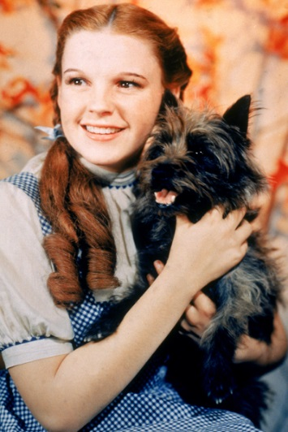
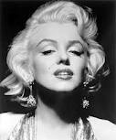
Barbiturates Cont.
Barbiturates are illegal without a prescription and, in fact, are a controlled substance like narcotics.
They can be highly addictive, and withdrawal may produce severe symptoms, including death.
They are especially dangerous when combined with alcohol.
Judy Garland died from an unintentional overdose of barbiturates, she was only 47.
Marilyn Monroe died from a combination of barbiturate use with alcohol, she was just 36 years old.

Slide 46
Barbiturate Effects
Decreased attention span
Memory impairment
Impaired thinking
Decreased blood pressure and heart rate
Fainting
Nausea and vomiting
Impaired motor coordination
Slurred speech
Impaired memory and judgment
Coma
Death from depression of respiratory centers in the brain

Slide 47
Barbiturates Cont.
Traditionally, barbiturates are divided into four groups based on the duration of their effects: long-lasting, intermediate acting, short-acting and very short acting.
The duration of the effects of barbiturates can range last from two to three hours for the short-acting forms to as long as six to 10 hours for the longer-acting drugs.

Slide 48
Barbiturates Cont.
Barbiturates are addictive!
Tolerance and psychological and physical dependence may occur with continued use of barbiturates. Tolerance simply means that larger and larger doses of the drug are required to obtain the same effect.
They crave the drug after its effects disappear – may increase the dosage or decrease the time between doses, which may then lead to a physical dependency

Slide 49
Heroin
Heroin was first extracted from morphine in 1874, and it was used widely as a painkiller.
Pure heroin is a white powder with a bitter taste which is usually dissolved and injected.
Heroin found "on the street" may vary in color from white to dark brown, depending on the amount of impurities from additives such as food coloring, cocoa, or brown sugar.
Extremely Addictive!

Slide 50
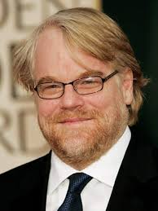
Heroin Cont.
Snorting or smoking is likely more appealing to many abusers because it removes both the fear of contracting diseases through the use of a syringe
However, once hooked, many abusers who started by snorting or smoking, shift to intravenous heroin use as price dictates.
Glee Actor Corey Monteith died from an overdose of heroin and alcohol, he was 31 years old.
Actor Phillip Seymour Hoffman recently died this year due to a heroin overdose.

Slide 51
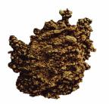
Heroin Cont.
Symptoms and signs of heroin use include:
euphoria
drowsiness
respiratory depression
constricted pupils
nausea
This is a picture of heroin, as you can see it’s not white, so it has additives in it.

Slide 52
Heroin Cont.
Oxycontin users tend to become heroin addicts because of the cost.
Withdrawal symptoms include:
dilated pupils
watery eyes
runny nose
yawning
loss of appetite
tremors
panic
chills
sweating
nausea
muscle cramps
insomnia
As withdrawal progresses, elevations in blood pressure, pulse, respiratory rate and temperature occur.
Symptoms of overdose -- which may result in death -- include shallow breathing, clammy skin, convulsions and coma.

Slide 53
Opioids
Examples of Rx Opioids:
Hydrocodone (Vicodan)
Oxycodone (Oxycontin)
Morphine
Diamorphine (Heroin)
Oxymorphone (Opana)
Fentanyl
Codeine
Darvon
Demerol
Dilaudid

Slide 54
Short Term Long Term
Changes the way the brain responds to pain
Euphoria
Drowsiness
Constipation
Large doses can depress breathing
Impaired judgment
Tolerance
Severe Addiction
Severe withdrawal, which can include restlessness, muscle and bone pain, insomnia, diarrhea, vomiting, cold flashes with goose bumps, and involuntary leg movements.
Sense of desperation if drug is not immediately available

Slide 55
Marijuana
THC is the active ingredient, comes from the cannabis plant. It attaches to receptors in the brain that are responsible for memory, pain, hunger. Marijuana users are 15 times more likely to use cocaine than non-users. Why?
Short Term Effects:
Increased heart rate that may last for up to 3 hours
Heart palpitations and arrhythmia
Distorted perceptions
Impaired coordination
Difficulty with thinking and problem solving
Impaired judgment
You also don’t know what could be mixed in with it.
Marijuana isn’t put in a single drug category because it depends on the user. It has stimulant and depressant qualities so it’s referred to as a psychoactive drug.

Slide 56
Long Term Effects
Adverse impact on memory and learning: effects can last for days or weeks after the acute effects of the drug wear off. As a result, someone who smokes marijuana every day may be functioning at a suboptimal (lower) intellectual level all of the time.
Addiction: about 9 percent of users become addicted to marijuana; this number increases among those who start young (to about 17 percent) and among daily users (25-50 percent).
Increased risk of mental illness: specifically anxiety, depression, and schizophrenia
Cancer: Marijuana smoke contains 50% - 70% more carcinogens than cigarette smoke. Smoking 4 joints is loosely equivalent to smoking 1 pack of cigarettes.
Respiratory problems: chronic bronchitis, chronic chough, etc.
Reduced resistance to infection: THC has been shown to suppress a variety of immune cells in the body.
Impaired achievement: long term use decreases motivation, cognitive ability, career success, and social interaction. Thickens the synaptic fluid in the brain causing users to appear lower than usual in terms of intelligence.

Slide 57
Smoking Marijuana while pregnant
According to studies in 2014 they found…
The active ingredient in marijuana, THC, interferes with the formation of connections between nerve cells in the cerebral cortex, the part of the brain responsible for higher thinking skills and forming memories.
The effects of prenatal marijuana exposure could even last into adulthood. The drug could have direct effects, or it could sensitize the brain to future drug exposure or neuropsychiatric illnesses.
Previous long-term studies have shown that children exposed to marijuana in the womb may have an increased risk of showing cognitive effects, seeking out drugs, or having attention deficit disorder, anxiety or depression

Slide 58
Spice
While Spice products do contain dried plant material, chemical analyses of seized spice mixtures have revealed the presence of synthetic (or designer) cannabinoid compounds.
The chemical composition of products sold as Spice is largely unknown. You don’t know what’s in it and you don’t know how you will react to it-DANGEROUS!
Spice is an illicit drug because, while sold legally as incense, the package is marked “not for human consumption.” When humans use substances not intended for consumption, it is illicit substance use.

Slide 59
Other Drugs (we won’t test over these)
DRUG:
-Bath Salts
-Mushrooms “shrooms”
What it is/does:
-Stimulant- similar to meth (extremely paranoid behavior, excitement, high blood pressure and heart rate, delusions & hallucinations)
-Hallucinogen- disrupts the neurotransmitter serotonin in the brain- distorted thought process, hallucinations, flashbacks (similar to LSD)

Slide 60
How do drugs affect babies?
http://www.5min.com/Video/Struggles-of-Drug-Addicted-Babies-516942795

Slide 61
It seems pretty obvious…
You want your kids to have the best life possible, make sure they are starting out that way by not putting ANYTHING that could potentially harm them into your body.
You want to be sure that you are providing your child with the care and attention they deserve and that involves not choosing to use drugs yourself.
You also need to keep them around people that are good role models.
Your kids should always come FIRST!

Slide 62
True Effects of Addiction
Addiction is destructive…
Grades
Friendships
Trust
Families
Kids get taken away
Career
Physical and mental health
Self-worth and self-esteem
Integrity
Goals
Freedom
…and DENIAL keeps a user from believing that using drugs has caused the destruction and that they have a problem!

Slide 63
So…if drugs have so many negative effects
1) Why do people start using them?
2) Why do people feel it’s okay to use some drugs but not others when they all have bad effects?
3) Why do some drugs lead to the use of other drugs?
4) Why is it important to have your values and morals on such issues in place at the age that you are?

Slide 64
That is all of the club drug notes. Please keep in mind you will be responsible for everything covered in class and in the notes and book readings on the test.
Test will be: __________________!!!
You will definitely need to STUDY for this one!!!!

Slide 65
Great websites:
http://abovetheinfluence.com/facts/drugfacts
http://justthinktwice.com/
http://www.methfreetn.org/

Slide 66
Works Cited
http://www.health.org/nongovpubs/ketamine/#define
http://www.theantidrug.com/drug_info/drug_info_lsd.asp
http://www.drugabuse.gov/Published_Articles/fundrugs.html
http://www.streetdrugs.org/pcp.htm
http://faculty.washington.edu/chudler/coca.html
http://www.whitehousedrugpolicy.gov/drugfact/crack/
http://faculty.washington.edu/chudler/amp.html
http://www.detox911.com/history_of_heroin_overture.html
http://www.livescience.com/42853-marijuana-during-pregnancy-baby-brain.html

