Slide 1
Health Ch. 1 Your Health and Wellness
Mrs. Scott’s Class

Slide 2
Health and Wellness
Health- combination of physical, mental and social wellbeing.
Spiritual Health- a deep sense of the meaning and purpose of life and understanding right from wrong.
Wellness- An overall state of well-being, or total health.
Health Education- Providing accurate health information to help people make healthy decisions.
Questions:
1) Is your health always the same? Explain.

Slide 3
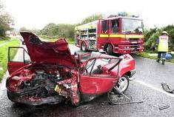
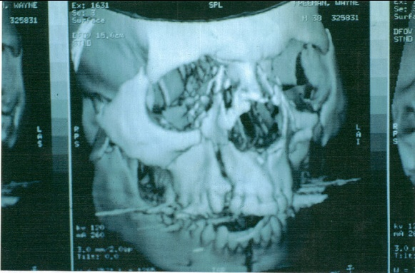
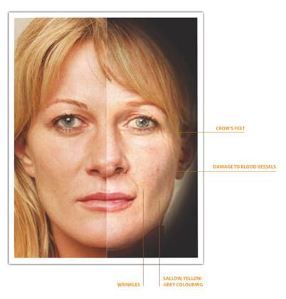
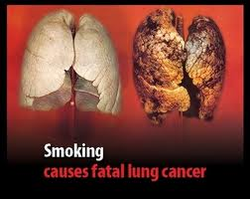
Promoting Health
The choices you make each day affect your overall health.
Time can vary:
Not wearing your seatbelt just one time
Smoking Cigarettes

Slide 4
Lifestyle Factors:
How much you exercise
What you eat
Sleep patterns
Managing Stress
Safe behaviors
Abstaining from sex
Stress
Maintaining Positive Relationships
(staying out of trouble and drama)
Avoiding drugs, tobacco, alcohol

Slide 5
5 Components of Health
Physical
Mental
Social
Emotional
Spiritual

Slide 6
Physical Health
This is also broken down into 5 parts:
*Cardiorespiratory endurance - the efficiency of how the body takes in oxygen for aerobic activities. * Muscular strength - the greatest amount of force a muscle or muscle group can exert in a single effort. * Muscular endurance - the ability of a muscle or muscle group to perform repeated movements for extended periods of times. * Flexibility - the ability to move the joints or any group of joints through an entire, normal range of motion. * Body composition - the percentage of body fat a person has in comparison to his or her total body mass.
Think of a type of athlete that displays the qualities for each of the 5 parts. Are they going to be perfect in each of the 5 parts?

Slide 7
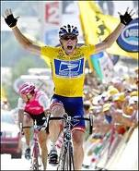
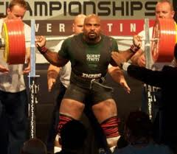
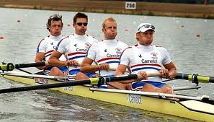
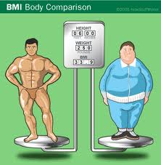
Examples:
Cardiorespiratory Endurance
Muscular Strength
Muscular Endurance
Flexibility Body Composition

Slide 8
Mental and Emotional Health
Mental- being able to think logically/realistically.
Emotional- understanding how you are feeling and how others around you are feeling.
Qualities of good mental health:
The ability to enjoy life, learn new things.
The ability to “bounce back” after something bad happens.
The ability to have a good balance in time spent with others and alone.
The ability to be flexible to change and/or acceptance of others opinions.
Coming to a point of self actualization- making the most of your abilities/gifts/potential.

Slide 9
Social Health
Social health often deals with how people relate to each other, and how an individual is able to socialize with other people and form relationships. This can deal with friendships, in terms of how well the person can form and keep friendships, and other types of relationships as well such as family relationships, peers, job settings, people of varying ages, etc.
Questions:
Do you act the same in each and every social setting? Why/Why not?
Do you know how to act in a socially appropriate manner? Explain.

Slide 10
Influences on your Health
Heredity
All the traits you received from your biological parents.
Environment
The people and physical surroundings (family, friends, peers, neighbors, coworkers, etc) that you are in.
Physical Environment- the actual surroundings (high crime, lots of pollution, etc)
Social Environment- people you are around
Culture- the beliefs, customs and behaviors of a particular group.
Media and Technology
What you have accessible to you in your area via the internet, medical advances, health information, etc.

Slide 11
Influences on your Health Cont.
Your values, attitude and behavior
Values- what you consider to be important and center your life around.
Attitude- the way you view situation. People who think in a positive way have better health than those that think negatively.
Behavior- You have most control over how you actually handle the situation.

Slide 12
Reducing Health Risks
Make yourself aware of Risk Behaviors- these are actions that can potentially threaten your health or the health of others.
Understanding Cumulative Risks- risk factors that increase in effect with each added risk.
Question:
Give an example of a cumulative risk.
Prevention- taking steps to keep something from happening, happening again, or getting worse. Give an example of this.
Abstaining- a deliberate decision to avoid a high risk behavior like doing drugs, alcohol, participating in sexual activity.

Slide 13
Healthy People
The document that comes out every 10 years that aims at improving the health of all people nationwide.
Promotes health and prevents illness, disability and early death.
Their 2 main goals:
1) Increase the quality and length of healthy life for all Americans.
2) Remove differences in health outcomes that result from the following factors: gender, race, education, disability and location. These differences in health outcomes among groups are called health disparities. (basically the difference in some form of health between two groups based on a common factor like education level, gender, race, etc)

Slide 14
Health Literacy
Health Literacy- a person’s ability to learn and understand basic health knowledge.
Must be:
Critical thinker and problem solver
A person who acts in a responsible way that has respect for themselves and others.
A self-directed learner (knows how to find accurate and reliable information though media, internet and health care professionals)
An effective communicator, a person who can express/display their health knowledge in a variety of ways.

Slide 15
Keeping a Balance
You need to be able to keep a good balance between the 3 main parts of health. Physical, Mental/Emotional, and Social.

