Slide 1
Sexually Transmitted Diseases/Infections
Mrs. Scott’s Class

Slide 2
What are STD’s/STI’s?
STD’s or STI’s (Sexually Transmitted Infections) are infections spread from person to person through sexual contact.
In the United States STD’s are an epidemic (many people in the same place at the same time are affected with the disease)
Many STD’s have little or no symptoms, which is why many people do not realize that they are infected.

Slide 3
What Is Hepatitis A?
In children, the most common form.
This form is caused by the hepatitis A virus (HAV), which lives in the stools (feces or poop) of infected individuals.
Infected stool can be present in small amounts in food and on objects (from door knobs to diapers).

Slide 4
How is it Spread?
When someone ingests anything that's contaminated with HAV-infected stool (This makes it easy for the virus to spread in overcrowded, unsanitary living conditions.)
In water, milk, and foods, especially in shellfish

Slide 5
Other Information
This type does not cause chronic liver damage.

Slide 6
What Is Hepatitis B?
Hepatitis B (also called serum hepatitis) is typically spread through infected bodily fluids.
HBV can cause a wide spectrum of symptoms ranging from general malaise to chronic liver disease that can lead to liver cancer.

Slide 7
How is it Spread?
infected body fluids, such as blood, saliva, semen, vaginal fluids, tears, breast milk, and urine
#1 way- sexual activity with an HBV-infected person
transmission from HBV-infected mothers to their newborn babies
a contaminated blood transfusion (uncommon in the United States)
shared contaminated needles or syringes for injecting drugs

Slide 8
What Is Hepatitis C?
The hepatitis C virus (HCV) is spread by direct contact with an infected person's blood.
The symptoms of the hepatitis C virus can be very similar to those of the hepatitis A and B viruses.
However, infection with the hepatitis C virus can lead to chronic liver disease and is the leading reason for liver transplant in the United States.

Slide 9
How is it Spread?
sharing drug needles
getting a tattoo or body piercing with unsterilized tools
blood transfusions (especially ones that occurred before 1992; since then the U.S. blood supply has been routinely screened for the disease)
transmission from mother to newborn
sexual contact (although this is less common)

Slide 10
Signs and Symptoms
Hepatitis, in its early stages, may cause flu-like symptoms, including:
malaise (a general ill feeling)
Flu characteristics
jaundice (a yellowing of the skin and whites of the eyes) because of liver damage
But some people with hepatitis may have no symptoms at all

Slide 11
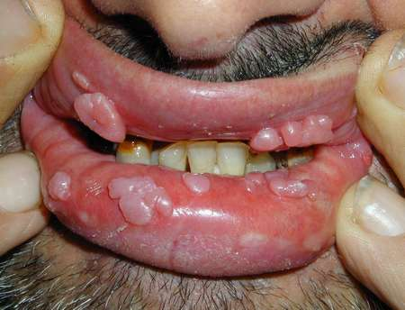
Genital Warts
Genital warts, sometimes called venereal warts, are contracted through sexual contact. They're spread by direct, skin-to-skin contact during vaginal, anal, or oral sex with an infected person. (Infants can be infected by their mothers during birth, but this is rare.)
This guy has venereal warts of the mouth

Slide 12
Info. about HPV
Genital warts are caused by certain types of the human papillomavirus (HPV). But other common types of HPV that cause warts on the hands and the soles of the feet do not cause genital warts.
Genital HPV infection is one of the most common sexually transmitted diseases (STDs) in the world. In fact, scientists estimate that as many as 6 million new cases of genital warts are diagnosed in the United States each year.

Slide 13
HPV Cont.
are growths or bumps that appear in and around the vagina or anus or on the cervix in females or on the penis, scrotum, groin, or thigh in males
can be raised or flat, single or multiple, or small or large
can cluster together to form a cauliflower-like shape
are usually flesh-colored and painless

Slide 14
HPV cont.
It may take several months or years after infection for symptoms to appear - if there are even symptoms at all.
The average incubation period is 1 to 6 months, but this can vary. Sometimes, the warts are so small and flat that they may not be noticed immediately.
In women, HPV can invade the internally (vagina and cervix). These warts may be flat and invisible. Because the virus can lead to changes in the cervix that may lead to cancer, it's important that this condition is diagnosed and treated. Men infected with HPV can also be at risk for cancer of the genital regions.
1/3 of the types of HPV cause cancer.

Slide 15
How is it Spread?
Genital warts are transmitted through sexual contact with an infected person. HPV can be contracted via anal, oral, and vaginal intercourse, and warts can appear within several weeks or months after sexual relations.
The virus is passed through skin-to-skin contact, but not everyone who's been exposed to the virus will develop genital warts. About two thirds of those who have sexual contact with an infected person will contract HPV.
More than 100 types of HPV have been identified; approximately one third of those are spread through sexual contact and live only in the genital tissue.

Slide 16
HPV Prevention
Like most STDs, genital warts can be avoided by not having sex.
Even birth control methods offer some protection against genital warts, but they can't completely prevent them because the warts can be outside of the area protected by the birth control. Spermicidal foams, creams, and jellies have not been proven to protect against HPV and genital warts.

Slide 17
Treatment of HPV
Most genital warts require two or more professional treatments. However, there's no cure for an HPV infection because treatment just removes the genital warts it causes.
The various therapies available for genital warts include:
Putting prescription medications on the warts
Freezing the warts with liquid nitrogen Using laser treatment
Because the HPV remains dormant in the body, genital warts may reappear at any time after treatment.

Slide 18
Other Info.
Because of the connection of some types of HPV to cancer, genital warts should be taken seriously and treated immediately.

Slide 19
Trichomoniasis
In the United States, it’s the most common STD and the highest number of cases are seen in women between age 16 and 35.
It’s spread through sexual contact with an infected partner.
This include vaginal intercourse and genital contact. The parasite cannot survive in the mouth or rectum.

Slide 20
Trichomoniasis Cont.
It’s caused by a PARASITE!
The infection usually does not cause symptoms in men and goes away on its own in a few weeks.

Slide 21
Trichomoniasis Symptoms
Females
Discomfort with intercourse
Itching of the inner thighs
Vaginal discharge (thin, greenish-yellow, frothy or foamy)
Vaginal itching
Vaginal odor (foul or strong smell)
Males
Burning after ejaculation or during intercourse
Itching of urethra
Discharge from urethra

Slide 22
Tests and Treatment
Females- pap smear or pelvic exam
Males- if their partners have it they’ll be put on medication
An antiparasitic medicine is typically given. You are not to have sex for 48 hrs afterward and are not to drink alcohol.

Slide 23
Aids/HIV
AIDS stands for acquired immunodeficiency syndrome, a disease that makes it difficult for the body to fight off infectious diseases.
The human immunodeficiency virus known as HIV causes AIDS by infecting and damaging part of the body's defenses against infection, namely the white blood cells known as lymphocytes, a type of white blood cell in the body's immune (infection-fighting) system that is supposed to fight off invading germs.

Slide 24
How is it Spread?
HIV can be transmitted through direct contact with the blood or body fluid of someone who is infected with the virus.
That contact usually comes from sharing needles or by having unprotected sex with an infected person. An infant could get HIV from a mother who is infected.

Slide 25
What does HIV do to the body?
The virus attacks specific lymphocytes called T helper cells (also known as T-cells), takes them over, and multiplies. This destroys more T-cells, which damages the body's ability to fight off invading germs and disease.

Slide 26
The three main ways the HIV virus is passed to a very young child are:
while the baby develops in the mother's uterus (intrauterine)
at the time of birth
during breastfeeding

Slide 27
Symptoms of AIDS/HIV
Teens and young adults who contract HIV usually show no symptoms at the time of infection. In fact, it may take up to 10 years or more for symptoms to show. During this time, they can pass on the virus without even knowing they have it themselves. Once the symptoms of AIDS appear, they can include rapid weight loss, intense fatigue, swollen lymph nodes, persistent diarrhea, night sweats, or pneumonia. They, too, will be susceptible to life-threatening opportunistic infections

Slide 28
HIV is not spread through:
casual contact, such as hugs or handshakes
drinking glasses
sneezes
coughs
mosquitoes or other insects
towels
toilet seats
doorknobs

Slide 29
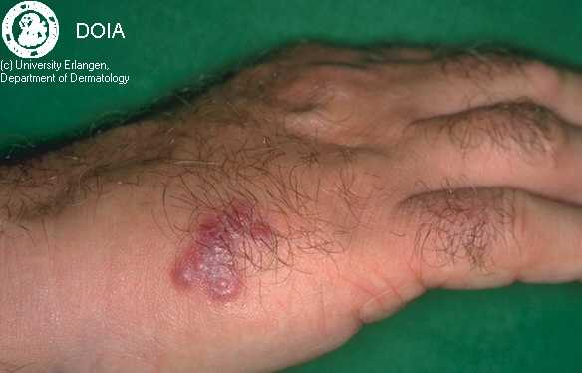
Herpes
Herpes simplex infections commonly cause either cold sores around the mouth or blisters in the genital area (also known as genital herpes). The two strains of HSV (named type 1 and type 2) each cause different signs and symptoms and differ as to where the herpes lesions occur.

Slide 30
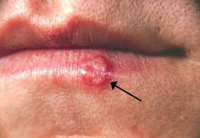
Type 1
Cold sores around the mouth are most often caused by the herpes simplex virus - type 1 (HSV-1 or gingivostomatitis). HSV-1 is usually transmitted from person to person by saliva or direct contact. People may have several episodes of cold sores during a lifetime, and in young children the first (primary) episode can be more bothersome.

Slide 31
Type 2
Genital herpes is most often caused by the herpes simplex virus - type 2 (HSV-2). Occurring mainly in sexually active adolescents or adults, HSV-2 is usually transmitted person to person by intimate contact.
Symptoms typically begin with pain, tenderness, or an itch in the genital area and occur with fever, headache, and malaise (a generally ill feeling). Blisters soon appear on the penis in males and on the area around the vagina in females.

Slide 32
How is it Spread?
Both herpes simplex viruses, HSV-1 and HSV-2, are contagious and may be passed from person to person by contact with herpes sores or blisters. HSV-1 may be passed in the saliva of persons with cold sores and HSV-2 may be passed in the urine or genital fluids of someone with genital herpes. Importantly, in both HSV-1 and HSV-2 infections, there is a percentage of infected persons who pass infectious herpes viruses in their body fluids without having any symptoms of an active herpes infection.
Pregnant women with genital herpes (HSV-2) can pass potentially life-threatening herpes infection to their newborns during vaginal delivery.

Slide 33
Prevention against Herpes
Herpes simplex infections can be prevented by avoiding direct contact with sores or ulcers of someone who has an active herpes infection - either on the mouth or on the genitals.
Individuals who are sexually active should use a birth control during sexual activity, but even condoms will not completely eliminate the risk of spreading genital herpes while there are active lesions. So, the best prevention is not to be sexually active.

Slide 34
Gonorrhea
Gonorrhea is a sexually transmitted disease (STD) caused by bacteria called Neisseria gonorrhoeae.
The bacteria can be passed from one person to another through vaginal, oral, or anal sex, even when the person who is infected has no symptoms. They can also be passed from a mother to her baby during birth. You cannot catch gonorrhea from a towel, a doorknob, or a toilet seat.

Slide 35
Girl’s Symptoms-Gonnorhea
A girl who has gonorrhea may have no symptoms at all or her symptoms may be so mild that she doesn't notice them until they become more severe. In some cases, girls will feel a burning sensation when they urinate, or they will have a yellow-green vaginal discharge. Girls may also experience vaginal bleeding between menstrual periods.
If the infection becomes more widespread and moves into the uterus or fallopian tubes, it may cause abdominal pain, fever, and pain during sexual intercourse, as well as the symptoms above. (This widespread infection is called pelvic inflammatory disease or PID.)

Slide 36
Male Symptoms- Gonnorhea
A guy who has gonorrhea is much more likely to notice symptoms, although a guy can have gonorrhea and not know it. Guys often feel a burning sensation when they urinate, and yellowish-white discharge may ooze out of the urethra (at the tip of the penis).

Slide 37
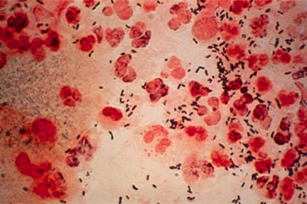
What can happen?
In girls, the infection can move into the uterus, fallopian tubes, and ovaries (causing PID) and can lead to scarring and infertility (the inability to have a baby). Gonorrhea infection during pregnancy can cause problems for the newborn baby, including meningitis (an inflammation of the membranes around the brain and spinal cord) and an eye infection that can result in blindness if it is not treated.
This is the bacteria

Slide 38
What can happen cont.
In guys, gonorrhea can spread to the epididymis (the structure attached to the testicle that helps transport sperm), causing pain and swelling in the testicular area. This can create scar tissue that might make a guy infertile.
In both guys and girls, gonorrhea can affect other organs and parts of the body including the throat, eyes, heart, brain, skin, and joints, although this is less common.

Slide 39
Treatment
If you think you may have gonorrhea or if you have had a partner who may have gonorrhea, you need to see your doctor or gynecologist. He or she will do an exam and swab the vagina or penis for discharge, which will then be analyzed. The doctor may also test for other STDs, such as syphilis or chlamydia.
If you are diagnosed with gonorrhea, your doctor will prescribe antibiotics to treat the infection. Anyone with whom you've had sex should also be checked for gonorrhea immediately.

Slide 40
Chlamydia
Chlamydia is a sexually transmitted disease (STD) that is caused by bacteria called Chlamydia trachomatis. Although you may not have heard its name, chlamydia is one of the most common sexually transmitted diseases. Because many people don't have any symptoms, though, lots of people can have chlamydia and not know it.

Slide 41
How is it Spread?
The bacteria can move from one person to another through sexual intercourse or oral-genital contact. If a person touches bodily fluids that contain the bacteria and then touches his or her eye, he or she may get a chlamydial eye infection.
Chlamydia can also be passed from a mother to her baby while the baby is being delivered. This can cause pneumonia and conjuntivitis, which can become very serious for the baby if it's not treated.
You can't catch chlamydia from a towel, doorknob, or toilet seat.

Slide 42
Female Symptoms
It can be difficult for a girl to know whether she has chlamydia because most girls don't have any symptoms. Chlamydia may cause an unusual white/yellow vaginal discharge or pain during urination. Some girls with chlamydia also have pain in their lower abdomens, pain during sexual intercourse, or bleeding between menstrual periods. Sometimes a chlamydia infection can cause a mild fever, muscle aches, or headache.

Slide 43
Male Symptoms
Like a girl, a guy can also have a difficult time telling whether he has chlamydia. Some guys may have a discharge from the tip of the penis (urethra - where urine comes out), or experience itching or burning sensations around the penis. Rarely, the testicles may become swollen. Many times, a guy with chlamydia may have few or no symptoms, so he might not even know he has it.

Slide 44
What can happen?
If left untreated in girls, chlamydia can cause an infection of the urethra (where urine comes out) and inflammation (swelling and soreness caused by the infection) of the cervix. It can also lead to pelvic inflammatory disease (PID), which can cause infertility.
If left untreated in guys, chlamydia can cause inflammation of the urethra and epididymis (the structure attached to the testicle that helps transport sperm).

Slide 45
Treatment
If you think you may have chlamydia or if you have had a partner who may have chlamydia, you need to see your family doctor, adolescent doctor, or gynecologist.
The doctor will do an exam and swab the vagina or penis for secretions, which will then be analyzed. Sometimes doctors can diagnose chlamydia by testing a person's urine. If you are diagnosed with chlamydia, the doctor will prescribe antibiotics, which should clear up the infection in a week.

Slide 46
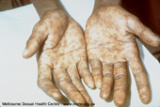
Syphilis
Syphilis- is a sexually transmitted disease caused by a bacteria that is known as a spirochete, the spirochetes that cause syphilis can be passed from one person to another through direct contact with a syphilis sore during sexual activity.

Slide 47
The Four Stages
Stage 1
Red, wet sores that don't hurt appear on the vagina, rectum, penis, or mouth.
Stage 2
If syphilis hasn't been treated yet, the person will usually break out in a rash, especially on the soles of the feet and palms of the hands.
Stage 3
“Latent Stage” this means that all the symptoms of the disease go away, but the disease is still very much there.
Stage 4
Tertiary Syphilis. This means the spirochetes have spread all over the body and can affect the brain, the heart, the spinal cord, and bones. Symptoms of late syphilis can include difficulty walking, numbness, gradual blindness, and possibly even death.

Slide 48
Treatment and Other Facts
If you think you may have syphilis or if you have had sexual contact with someone who may have syphilis, you need to see your doctor or gynecologist right away. As it can sometimes be difficult to spot chancres, it's important to get checked on a regular basis, especially if you have had unprotected sex and/or more than one sex partner.
Syphilis also increases the risk of HIV infection, because HIV can enter the body more easily when there's a sore present.

Slide 49
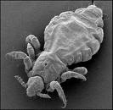
Pubic Lice
Pubic lice are tiny insects that can crawl from the pubic hair of one person to the pubic hair of another person during sexual intercourse. You can also catch pubic lice from infested clothing, towels, and bedding.
Once they are on a person's body, the insects live by sucking blood from their host. Pubic lice are sometimes called "crabs" because when seen under a microscope they look like tiny crabs.

Slide 50
How do you know if you have it?
Pubic lice cause intense itching. A person who has been exposed to pubic lice may notice tiny, gray insects crawling in their pubic hair. He or she may also see tiny (about the size of the head of a pin), oval-shaped, white blobs called nits clinging to the hair. Nits are the louse eggs, and they can't be easily removed from the hair with the fingers, so there are "nit combs" that can be purchased at pharmacies.

Slide 51
What can happen?
It's unusual for pubic lice to create any serious health problems, but the itching can be very uncomfortable, and it's easy to transmit them to others.
The female lice can survive up to 40 days and each can lay 20 to 30 eggs (yuck!). Lice can also live off the body for 2 to 3 days. Because of this it is important to get properly diagnosed and treated, or it can take forever to get rid of them.

Slide 52
Treatment
If you think you may have pubic lice or if you have had a partner who may have pubic lice, you need to see a doctor or gynecologist right away. If he or she diagnoses pubic lice, you may be prescribed medication or told to buy an over-the-counter medicine that kills the lice and their eggs. The important thing to remember is that the treatment you use may need to be repeated in 1-2 weeks to kill any lice you didn't get the first time.
You will also need to dry clean or use very hot water to wash all your bedding, towels, or recently worn clothing to properly kill the lice and their eggs.

Slide 53
Remember:
You should NEVER be pressured to do ANYTHING that you do not want to do.
When you have sex (any kind) with someone you are basically having sex with everyone they’ve had sex with. YUCK!

Slide 54
Keep in Mind!!!
Many, if not all, of the Sexually Transmitted Diseases can be transferred even if you use a birth control method. And birth control is not 100% protection. Some birth controls only help prevent pregnancy.
Keep yourself healthy, choose the 100% method-
ABSTINENCE!!

