Slide 1

Tobacco and Alcohol
Mrs. Scott’s Class
Health

Slide 2
Tobacco: What’s in that Stuff?
Tobacco use, especially smoking, is the #1 cause of preventable disease and death in the US.
Nicotine is the addictive drug that is found in the leaves of the tobacco plant.
  It is a stimulant.
    Speeds up heart rate, the central nervous system, and other organs.
  Once addicted it takes more and more tobacco to satisfy the craving.

Slide 3
Cigarette Smoke
Burning tobacco is classified into the most dangerous group of carcinogens.
  Carcinogens cause Cancer!
  This includes second-hand smoke.
  Contains: tar, carbon monoxide, over 43 other carcinogens, and other chemicals that are used in paint, toilet cleaners, antifreeze, and insecticides.

Slide 4
Tar
Sticky substance in smoke that destroys the cilia (that helps to prevents infection), the alveoli (air sacs), and lung tissue.
Causes lungs to be more apt to diseases like:
  bronchitis, pneumonia, emphysema, and cancer.
  Think of the tar that pavers put on the road when fixing pot holes. YUCK!

Slide 5
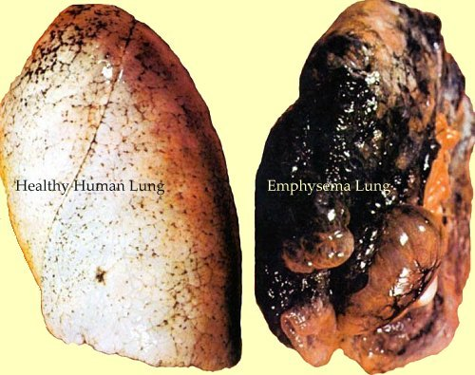

Slide 6
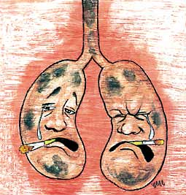
Carbon Monoxide
Colorless, odorless, poisonous gas that is taken up more readily by the blood than oxygen.
  This causes organs, tissues, and cells to be deprived of oxygen.
    Increases blood pressure, risk of heart disease, and hardening of the arteries.

Slide 7
Pipes/Cigars
Contains MORE nicotine than cigarettes!
  One cigar can have as much nicotine as one pack of cigarettes.
Contains MORE tar and carbon monoxide!
Increased risk of cancers of the throat, mouth, and lips.

Slide 8
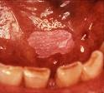
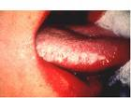
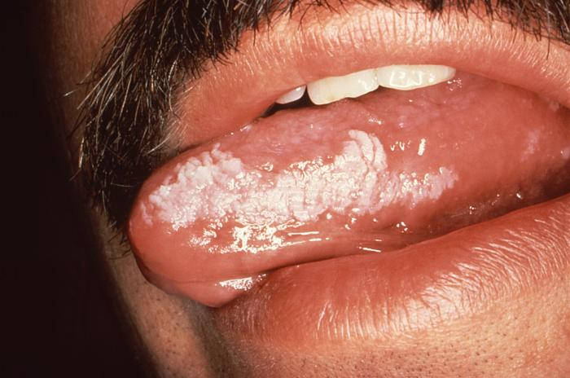
Smokeless (Chewing) Tobacco
Can be sniffed through the nose, held in the mouth, or chewed
Contains nicotine and over 28 carcinogens which are absorbed into the bloodstream through the mucous membranes and digestive tract
  Irritates the mouth lining causing leukoplakia (thick white spots which can develop into oral cancer.

Slide 9


Short Term Effects
Changes in brain chemistry (headaches, nervousness, trembling) as soon as 30 minutes after tobacco use.
Increase respiration and heart rate
Dulled taste buds and reduced appetite.
Bad Breath, Smelly Hair, Clothes, and Skin
Kissing someone who smokes is like licking an ashtray!

Slide 10
Long Term Effects
Chronic Bronchitis- cilia no longer function leads to build up of tar in the lungs, increase mucus secretion
Emphysema- tiny air sacs are destroyed, extremely hard to breath, lungs are not absorbing oxygen. Like breathing through a straw.
Lung Cancer- Cilia in the bronchi are destroyed, cancerous cells can grow in these conditions.
Heart Disease and Stroke- nicotine constricts blood vessels or blood flow, also contributes to plaque buildup which causes hardened arteries. This can lead to heart attacks.

Slide 11
Secondhand Smoke
Two Types:
  Sidestream- comes from the end of the burning tobacco.
    This one is more dangerous because it has a higher concentration of carcinogens, nicotine, and tar.
  Mainstream- smoke inhaled and exhaled from the lungs of a smoker.

Slide 12
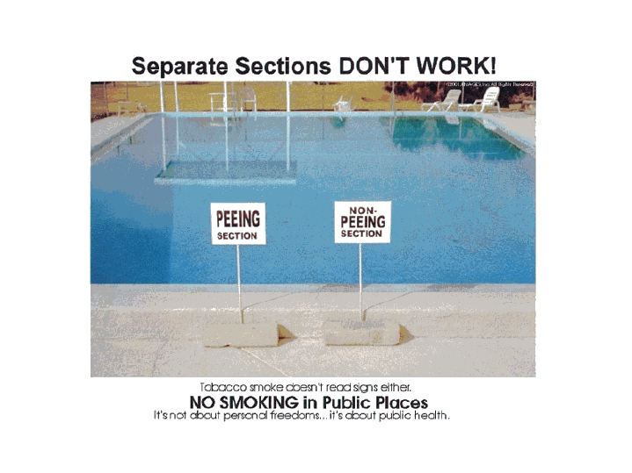
Secondhand Smoke
Secondhand smoke is a widespread threat to public health. According to the Surgeon General, "there is no safe level of exposure to secondhand smoke," and smoke-free policies are the only effective way to protect nonsmokers from the health hazards of secondhand smoke.
Sitting in non-smoking sections of a restaurant do not protect you completely.
If you can smell it, you’re breathing it in!
Luckily, all restaurants in Louisville and Southern Indiana are smoke free, if you eat indoors.

Slide 13
More Secondhand Smoke Facts:
Secondhand smoke contains 11 known cancer-causing poisons and 250 known toxins.
In 2007, 49,000 nonsmokers died from secondhand smoke.

Slide 14
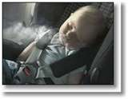
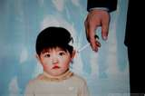
Secondhand Smoke Cont.
For children, breathing secondhand smoke causes:
  Acute respiratory infections and SIDS
  Increased risk of ear infections and sore throats, they stay sick a lot longer.
  Absent more from school
  Severe asthma
  Increases “acting out” behavioral problems, anxiety and depression
  Double the risk of developing lung cancer if they live with a smoker
  More likely to smoke themselves
Child Abuse
http://areyouokwiththat.com/facts/

Slide 15
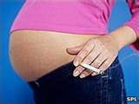
Smoking while pregnant:
  You have to be responsible when you become a parent, that includes not smoking and not being around people that smoke.
  Smoking damages the blood vessels (which is the reason it can cause heart attacks and stokes) and therefore harm the blood vessels of the baby and the placenta.
    The longer you smoke the more damage it does to the placenta and the more likely it is that your baby will be starving for food and oxygen. This the reason that many babies of smokers are smaller and stressed, and can be born prematurely.
  Heavy smoking can cause such damage to the placenta that it becomes detached from your uterine wall and cause the death of your baby (and serious risk for you too). In fact smoking is estimated to be responsible for around 10% of all prenatal infant deaths.
  Your child is born with nicotine dependence and will have to go through nicotine withdrawal in their first weeks of life as the baby becomes increasingly irritable as they withdraw from the drug.
  As a new mother, you are likely to be stressed enough with a new baby, but having to see and deal with it's addiction withdrawal is not something that I'd wish on anyone!
http://ezinearticles.com/?Effects-of-Smoking-While-Pregnant&id=880429

Slide 16
Smoke Free Benefits
Lowers risk of getting lung, mouth, throat cancer, heart disease, and stroke.
Improves cardiovascular endurance and lung function.
You’re not dependent upon something.
You don’t STINK!
You’ll have healthier skin, less wrinkles, and fresh breath!

Slide 17
Deaths in Indiana from Smoking
Adults who die each year from their own smoking-9,700
Kids now under 18 and alive in Indiana who will ultimately die prematurely from smoking 160,000
Smoking kills more people than alcohol, AIDS, car crashes, illegal drugs, murders, and suicides combined — and thousands more die from other tobacco-related causes — such as fires caused by smoking (more than 1,000 deaths/year nationwide) and smokeless tobacco use.

Slide 18
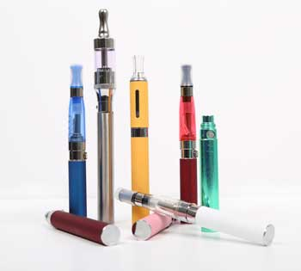
E-Cigarettes
Battery-operated devices designed to deliver nicotine with flavorings and other chemicals to users in vapor instead of smoke.
They can resemble traditional tobacco cigarettes, cigars or pipes, or even everyday items like pens or USB memory sticks. More than 250 different e-cigarette brands are currently on the market.

Slide 19
E-Cigarette Effects
Although they do not produce tobacco smoke, e-cigarettes still contain nicotine and other potentially harmful chemicals.
Nicotine is a highly addictive drug, and recent research suggests nicotine exposure may also prime the brain to become addicted to other substances.
Users can still experience all of the health consequences from stimulant use: constriction of arteries, heart attacks, etc.

Slide 20
More effects
Testing of some e-cigarette products found the vapor to contain known carcinogens and toxic chemicals (such as formaldehyde), as well as potentially toxic metal nanoparticles from the vaporizing mechanism. The health consequences of repeated exposure to these chemicals are not yet clear, especially because the contents are not regulated by the FDA.
Another worry is the refillable cartridges used by some e-cigarettes. Users may expose themselves to potentially toxic levels of nicotine when refilling them.

Slide 21
E-Cigarette Facts
Teens are more likely to use them because of their accessibility to get them, flavors and they see them as being a safe alternative.
They were originally thought of as being a good replacement for cigarettes but there isn’t significant research that proves this. Instead most e-cigarette users also use regular cigarettes as well and they are not decreasing their use of the nicotine in these products.
There are so many unknowns when it comes to these products because they are so new. They are not safe, I’m sure we will see many cases of the harmful effects in future years.

Slide 22
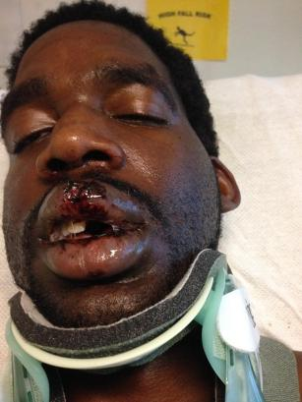
Recent Cases of Injury
Last February, a 17-year-old boy was injured while smoking an e-cigarette in Anaheim, California.
In March, CBS Los Angeles reports a Santa Ana man was injured after his e-cigarette blew up in his hands. The explosion sent half of the electronic smoking device into the ceiling and started a fire at his apartment.
A Colorado Springs man was seriously injured in November when an e-cigarette exploded in his face, leaving him hospitalized with a broken neck, facial fractures and burns.
http://www.cnn.com/2016/02/25/health/e-cigarette-explodes-in-mans-pocket/
Is smoking really worth it??

Slide 23
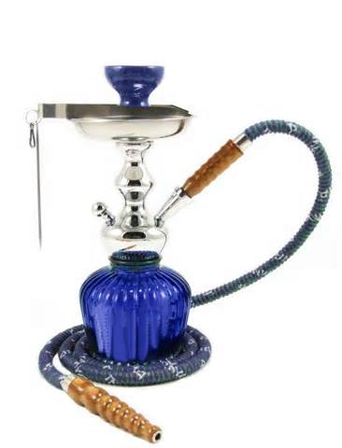
Hookah Myths and Truths
http://www.health.umd.edu/sites/default/files/Hookah%20Brochure-%20Final_0.pdf

Slide 24
Recap: List 3 reasons why you should never use tobacco-related products:

Slide 25


Alcohol
Alcoholic beverages contain ethanol (that is the type of alcohol in them)
  Ethanol is produced from the fermentation of fruits, vegetables, and grains. That is the action of yeast on sugars.
  The Ethanol is then mixed with water, flavorings, and minerals to create specific tastes.
  Alcohol is a Depressant
    Drug that slows down the central nervous system, dilates the blood vessels

Slide 26

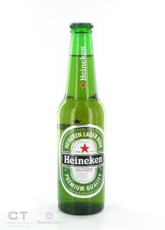

So, as a recap…
Which of the following has the most amount of ethanol in it?
A glass of wine A bottle of beer A shot of whiskey

Slide 27
Intoxication
The state in which the body is poisoned by alcohol or another substance and the person’s physical and mental controls significantly reduced.
It also lowers inhibitions, which can set one up for dangerous or embarrassing behavior. Alcohol is a drug and is only legal for people over the age 21.

Slide 28
Factors that Influence Alcohol’s Effects
Factors
Effects are quicker in:
Body Size
Gender
Food
Rate of Intake
Amount
Medicine

Slide 29
Medicine and Alcohol
Alcohol can change the effect of medicines, which can lead to illness or death. There are warning labels for a reason.
Body absorbs the alcohol or drug more slowly causing it to stay in the body longer.
It can increase or decrease the effectiveness of the drug.
Enzymes in the body can change some medicines and it can cause organ damage.

Slide 30
Alcohol’s Effects
Alcohol affects every part of the body. It is carried through the bloodstream to the brain, stomach, internal organs, liver, kidneys, muscles--everywhere. It is absorbed very quickly (as short as 5-10 minutes) and can stay in the body for several hours.
Alcohol affects the central nervous system and brain. It can make users loosen up, relax, and feel more comfortable or can make them more aggressive, weepy, overly affectionate.
Sooo…alcohol is absorbed faster if you’re…

Slide 31
Long Term Physical Effects
Damage to brain cells, reduction in brain size
Increased blood pressure – heart attacks, strokes.
Fatty liver- cell death
Damage to the digestive system organs.
  Some of these can be reversed if the person stops using.

Slide 32
Long Term Social Effects
Damage to relationships with loved ones (friends, family) can be life long.
A lot of people who are drinking say things they don’t mean, that is no excuse and doesn’t make the person they are saying it to not feel the pain of those hurtful words any less.

Slide 33
Poisoning and Death
According to the Substance Abuse and Mental Health Services Administration (SAMHSA), 2.6 million young people do not know that a person can die of an overdose of alcohol. Alcohol poisoning occurs when a person drinks a large quantity of alcohol in a short amount of time.
A standard drink is:
One 12-ounce bottle of beer or wine cooler
One 5-ounce glass of wine
1.5 ounces of 80-proof hard alcohol.
  All of these have the SAME amount of ethanol in them.

Slide 34
Binge Drinking
Drinking 4+ (women) 5+ (men) alcoholic drinks at one sitting.
It can lead to alcohol poisoning- a severe and potentially fatal physical reaction to an alcohol overdose.
  People can choke and die on their own vomit because alcohol has depressed the involuntary action of the gag reflex.

Slide 35
Health Hazards
People who begin drinking before the age of 15 are four times more likely to develop alcohol dependence than those who wait until age 21. Each additional year of delayed drinking onset reduces the probability of alcohol dependence by 14 percent.
Adolescents who drink heavily assume the same long-term health risks as adults who drink heavily. This means they are at increased risk of developing cirrhosis of the liver, pancreatitis, hemorrhagic stroke, and certain forms of cancer.

Slide 36
Health Hazards Cont.
Adolescents who use alcohol are more likely to become sexually active, which places them at greater risk of HIV infection and other sexually transmitted diseases as well as getting pregnant.
One study showed that students diagnosed with alcohol abuse were four times more likely to experience major depression than those without an alcohol problem.
Alcohol use among adolescents has been associated with considering planning, attempting, and completing suicide.

Slide 37
Factors that Influence Alcohol Use
Peer Pressure
Family
Media Messages
  Can you think of an example for this one??

Slide 38
The Law
It’s illegal for anyone under 21 to buy, possess, or consume alcohol.
Consequences vary, it can also make your college major unattainable because you have alcohol use in your record.

Slide 39


How is alcohol being portrayed in the following ads…

Slide 40
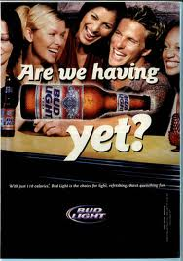
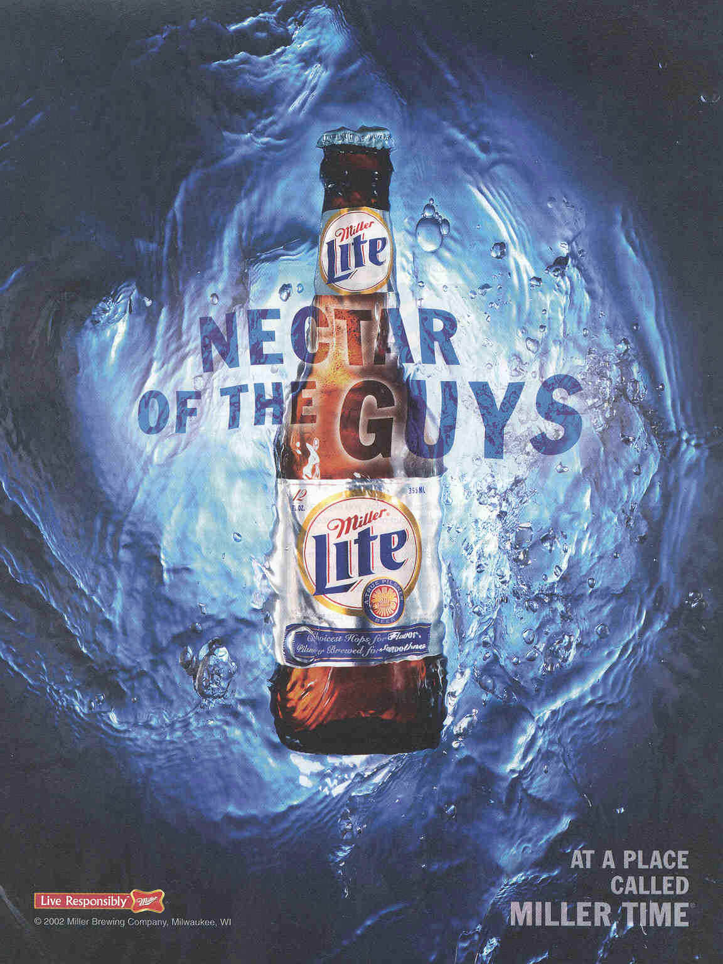

Slide 41



Slide 42
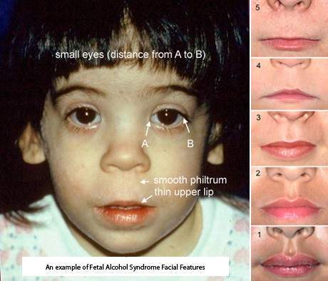
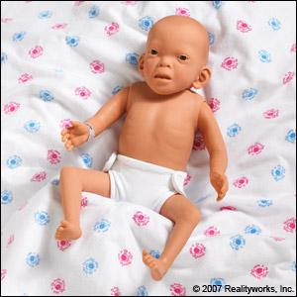
Fetal Alcohol Syndrome
Caused when a mother chooses to drink alcohol while she’s pregnant. It causes a huge risk in having a baby with FAS.
  Birth defects caused from alcohol use.
  Small head, deformed hands, feet, face
  Vision and hearing problems
  Heart, liver, kidney damage
  Hyperactivity, Learning difficulties
  It’s 100% PREVENTABLE!!!!!!
  DON’T DRINK DURING
  PREGNANCY!!!! YOUR BABY
  SHOULD BE YOUR #1 PRIORITY

Slide 43
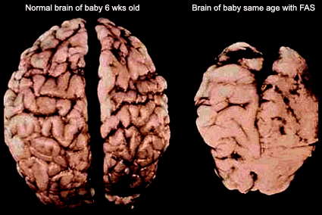
They are constantly behind their peers in terms of learning and problem solving throughout life, all because of something that was 100% preventable!

Slide 44
Alcohol Abuse
Excessive use of alcohol. It’s estimated that 25% of all youth are exposed to this within their families.
  Neglect
  Economic hardship
  Personal use of alcohol themselves
  Mental illness/physical problems.

Slide 45
Impact of Alcohol Abuse
Blood Alcohol Concentration (BAC)- the amount of alcohol in a persons bloodstream, given as a percent.
DWI/DUI = ILLEGAL
For those over 21 a 0.08 = charged with drunk driving, for those under 21 all percentages are illegal and can lead to injuries and death, arrest, jail time, loss of license, high insurance rates.
Buzzed driving is drunk driving!!

Slide 46
Benefits to being Alcohol Free
Maintain a healthy body- protects body organs from damage and decreases the chance of injury
Make responsible decisions
Avoid risky behaviors
Avoid illegal activities
You’re not causing extra added stress and worry to your family and friends.

Slide 47
How drugs affect your organs:
http://www.5min.com/Video/How-Substance-Abuse-Affects-Your-Organs-326720262

Slide 48
Don’t be like this guy…
http://www.youtube.com/watch?v=yDzcYerwE4s&feature=related

Slide 49
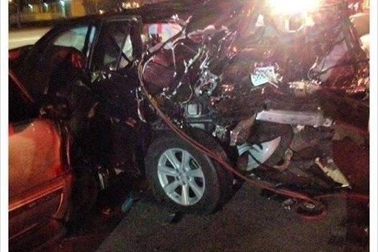

Don’t Drink and Drive
To end on a serious note…
This is Maci, she and her grandpa were killed by a drunk driver three years ago right after picking up a relative from the airport. She was 10 years old.

Slide 50
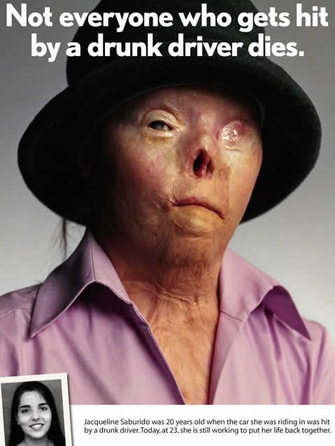
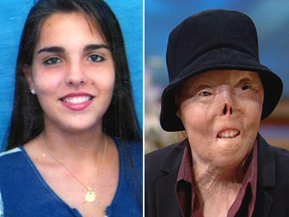
Jacqui’s Story
Jacqui Saburido is a living example of what true spirituality means. When she was just 19 years old, Jacqui and her friends were hit by a drunken driver. Two passengers were killed instantly. Jacqui was alive but suffered devastating burns on nearly 60 percent of her body. After 40 surgeries, Jacqui remained horribly disfigured. And, even though her everyday life is a struggle, Jacqui said she's glad to have survived. "I'm glad, because I want to live," she said. "I have a lot of things that I haven't had time to do yet."

Slide 51
Works Cited
http://theantidrug.mondosearch.com/cgi-bin/MsmFind.exe?CFGNAME=MssFind.cfg&query=drunk+driving
Health Book Ch. 21
http://areyouokwiththat.com/facts
http://www.tobaccofreekids.org/facts_issues/toll_us/indiana

